Slide 1
National ePrescribing Project
Brid Ryan
Clinical Lead ePharmacy
24 November 2023

Slide 2
UK 2023
Background
Estimated 1.8 million transition medication errors (without digital information standards)
Medicines are a critical pillar of the health system.
  They are the most common health intervention
  They have been associated with negative outcomes including death when there are errors during the medication process.
We want to use technology to help:
  Improve medication safety and reduce medication errors
  Improve the efficiency of the medication process
  Provide patients with access to their medicines information
Elliott, R., Camacho, E., Gavan, S., Keers, R., & Chuter, A. (2023). Estimating the impact of enabling NHS information systems to share patients’ medicines information digitally
Harm to 31,000
Deaths 45
Cost £17.4 M
Additional days 36,000
Expect 40%reduction with new standards
Notes:
https://pure.manchester.ac.uk/ws/portalfiles/portal/263159206/Meds_Interoperability_full_report_Elliott_et_al_2023.pdf
Estimating the impact of enabling NHS information systems to share patients’ medicines information digitally Document Version Final published version Link to publication record in Manchester Research Explorer Citation for published version (APA): Elliott, R., Camacho, E., Gavan, S., Keers, R., & Chuter, A. (2023). Estimating the impact of enabling NHS information systems to share patients’ medicines information digitally.
We calculated that the total number of transition medication errors (when using standard medicines reconciliation without the new digital information standards) was around 1.8 million in England per year, with almost 370,000 patients being admitted, transferred, or discharged experiencing a transition medication error. Over a year, around 31,000 people are estimated to experience harm from a transition medication error, with over half of these due to transition medication errors at hospital admission. The transition medication errors may lead to over 36,000 additional days spent in hospital, costing the NHS around £17.4 million per year. Approximately 45 people may die from these transition medication errors.

Slide 3
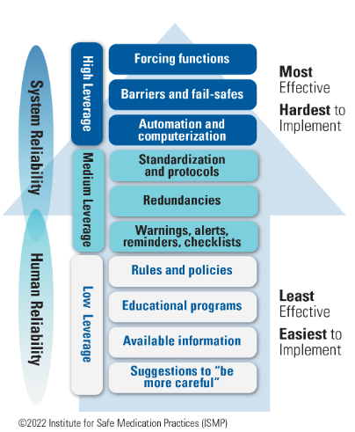
Medication Safety
Notes:
ISMP’s hierarchy of effectiveness of risk-reduction strategies.
- High-leverage strategies are most effective because they can eliminate the risk of errors and associated harm by ‘designing out’ hazards; however, they often require complex implementation plans.
- Medium-leverage strategies, which are easier to implement, reduce the likelihood of errors or minimize harm; however, they may need periodic updating and reinforcement.
- Low-leverage strategies, which aim to improve human performance, are easy and quick to implement; however, they are the least effective strategies for error prevention although frequently relied upon.
ISMP Hierarchy of Effectiveness of Risk-Reduction Strategies
Selecting the best risk reduction strategy to maximise medication safety is complex.
While education has been healthcare’s single go-to response to a quality or safety problem in the past, a new, more effective approach is now preferred.
A single strategy is not enough to change behaviours and prevent errors.
Instead, numerous high-leverage risk-reduction strategies that improve system reliability must be layered together, on top of education, to create a more robust safety system (ISMP, 2022)

Slide 4
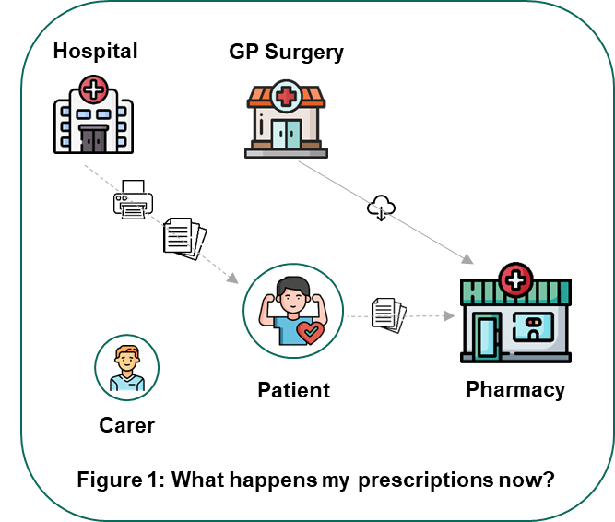
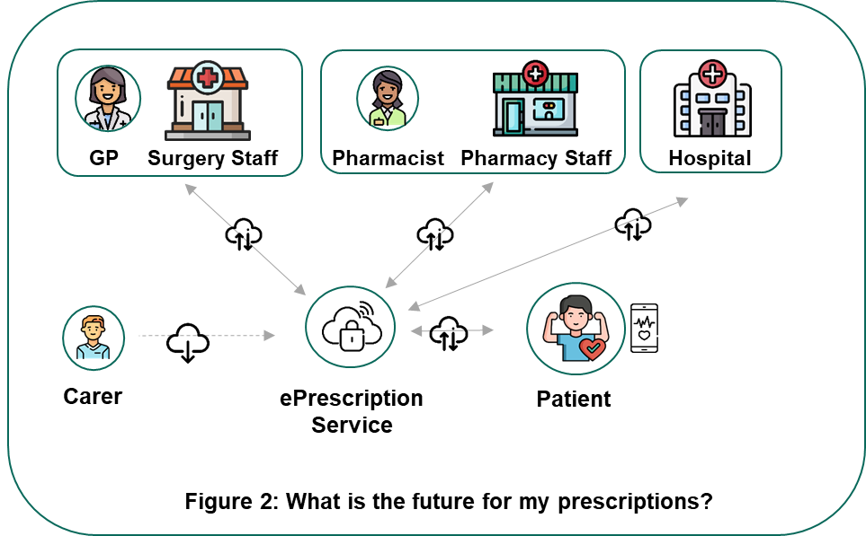
National ePrescribing Project Vision
Current State
Future State
Notes:
Need focus on fact that this is not a simple system and to integrate systems we need interoperabilty and standardisation.

Slide 5







Types of Standardisation
Standardisation
Unique patient identifier across all systems - IHI
Unique medicines identifier across all systems - NMPC
Unique health care professional identifier across all systems
Robust data flow - machine readable
Robust data flow - machine readable
Robust data flow across sectors
Robust security standards across all systems
Robust privacy standards across all systems
Notes:
To address this, all medication messages used by different NHS IT systems needs to be standardised. Messages need to be interoperable, meaning many different IT systems can exchange and make use of data and information across system and organisational boundaries.

Slide 6













Evolutionary pathway
Phase 1
Phase 2 or 3
Build Core
GP’s
Community Pharmacies
Patients
PCRS
Open NCP Readiness
Secondary Care
National ePrescribing Project
Subsequent Projects
Phase 2 or 3
Clinical decision support
Portal
Others e.g.
  Dental
  Optometry
  Prison
  Ambulance Service

Slide 7






What has been achieved?
High-level Business Case approved in principle by Digital Government Oversight Unit (DGOU)
Market consultation
Draft tender specifications under development
Prescribing and dispensing workflows for GP and community pharmacy mapped
Governance established
Stakeholder engagements
Staff recruited

Slide 8


Stakeholder Engagement

Slide 9





Early Stakeholder Engagement – Q1 2023
Early Engagement Sessions: 8
Total Participants: 44
Patients
Prescribers
Pharmacy
5
GP
1
7
National Patient Representative Panel
Community Pharmacists
Patients for Patient Safety Ireland
3
Nurse Prescribers
5
Hospital Pharmacists
3
Total
8
Non Consultant Hospital Doctors
2
Pharmacy Technicians
3
2
Consultants / Medication Safety
3
Primary Care Reimbursement Service
Dentists
2
Pharmaceutical Society of Ireland
3
Total
13
Medication Safety
3
Irish Pharmacy Union
2
Total
23

Slide 10


What is in it for me?
Patients
Healthcare Providers
I can:
Digitally access my health information
Check / view my ePrescriptions and eDispensations
Order my medicines from my pharmacy
Order a repeat prescription
See who has viewed my medicines information
I can:
Send ePrescriptions to the ePrescription Service
Cancel an ePrescription
Amend an ePrescription
View a patient's full medication list
Dispense a medication without needing to transcribe from an email or paper
Save time processing paperwork
Notes:
Rob:
Patients:
I want to contribute to my medication list e.g. OTC medicines, herbal medicines
I might like to communicate with my helth care professionsals using the patient app
Healthcare providers
I would like to know why a medication has been prescribed (the indication)
It will help me deliver care if I know why a medication has been cancelled

Slide 11
Early Engagement Stakeholder Feedback
Patients
Healthcare Providers
I can:
See all my medications in one place
Reduce my number of visits in and out of the doctor and pharmacy
Use a range of pharmacies
Be empowered to keep a medication list
Document my OTC medications
Engage with a user-friendly, inclusive system
Access reliable medication information abroad
I can:
See a patient’s full medication picture
Provide better care as a result of better information
More efficiently complete repetitive processes
Document patient allergies, indications in a structured way
Empower my patients to improve their compliance
Avail of a robust audit system to track access
Engage in more sustainable work practices
Notes:
Rob:
Patients:
I want to contribute to my medication list e.g. OTC medicines, herbal medicines
I might like to communicate with my helth care professionsals using the patient app
Healthcare providers
I would like to know why a medication has been prescribed (the indication)
It will help me deliver care if I know why a medication has been cancelled

Slide 12
Questionnaire Results
Overall Ranking | Benefits of ePrescribing
1 | ePrescribing will enable better and safer care when I move between healthcare settings
2 | I will be empowered to know my medications as I will have a list of them
3 | ePrescribing will help healthcare professionals make more informed decisions about my care
4 | ePrescribing can improve workflows so that healthcare professionals can spend more time with patients
5 | ePrescribing is convenient, I will spend less time attending my GP and community pharmacy
6 | I will be able to choose what community pharmacy I attend to collect my medications
7 | ePrescribing will be environmentally friendly, greener

Slide 13
Questionnaire Results

Slide 14
Questionnaire Results

Slide 15






Further Stakeholder Engagement – Q3 2023
What is HMMS?
Total Participants: 50
Patients
Prescribers
Pharmacy
HSE / Other
Technical
National Patient Forum | 1
Patient for Patient Safety Ireland | 5
Total | 6
GPs (ICGP/IMO) | 3
Nurse Prescribers | 5
Non Consultant Hospital Doctor | 2
Dentists | 1
Hospital Consultants* | 1
Total | 12
Community Pharmacy | 5
Hospital Pharmacy / Acute Hospitals Drugs Management Programme | 5
Regulatory | 2
Medication Safety | 2
National Cancer Control Programme | 1
Total | 15
Medicines Management Programme | 2
Primary Care Reimbursement Service | 2
Health Information and Quality Authority | 2
Other | 3
Total | 9
eHealth | 6
Primary Care Reimbursement Service | 1
Irish Pharmacy Union | 1
Total | 8
*Consultant was only present for introductory session
Notes:
Thank relevant groups.

Slide 16



Topics Covered
Wider consultation group
Seating plan to ensure mixing of representatives
Set the scene on the vision / governance / procurement
Main body of meeting was three workshops
  Short introduction
  20 mins to discuss area
  20 mins feedback to the room
  Notes on flip charts and note takers at tables
1
2
3
ePrescription and eDispensation
ePrescribing Patient App
Patient Medication List

Slide 17




Who does ePrescribing affect?
Nora - triage nurse
Dalila - student on holiday
“I am Nora and I work the nightshift in the A&E department. I hope ePrescribing will help me to see what medications my patients are currently prescribed, especially as some vulnerable patients may not be able to tell me themselves. ​
​
This hopefully would prevent patients being given unsuitable medications or medication they are allergic to. I hope it brings a positive change to my working life”
“I am on an extended holiday in Ireland with friends on my gap year. I don't have a PPSN.​
​
I recently have been unwell and needed to attend the GP for medications. I am worried that if I need to attend again when ePrescribing is in place that I will have trouble getting a prescription.​
​
Will I have issues accessing ePrescribing without a PPSN?"
Michael - patient
Paul - community pharmacist
“I am Michael and I was recently prescribed an anti-depressant. In my village there is only one community pharmacy. I went the pharmacy in next village as I wanted some privacy about my mental health.
I know healthcare staff take patient confidentiality seriously and have to abide by GDPR but will I have the same privacy when ePrescribing comes in?
“I work a community pharmacy with a lot of older and vulnerable patients. I am not sure how they will manage ePrescribing at the start.
This may make life busier for staff as we will be the face they see when they collect their medication.
My pharmacy opens late. What will happen if I can't access an ePrescription outside of office hours? ”

Slide 18
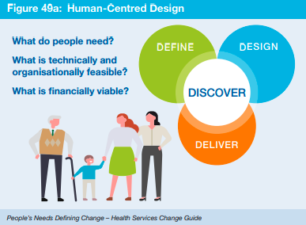
Consultation and collaboration

Slide 19

Next Steps

Slide 20
Next steps for 2023 / 2024
Step 1
Follow up dialogue and ongoing engagement with stakeholders and vendors on ePrescribing objectives.
Agree minimum viable product, draft future process map and data flows with end users.
Step 2
Step 3
Approve final requirement specifications for ePrescription Service
Step 4
Procurement - publish tender documents, review responses, select vendor for ePrescription Service
Notes:
Step 3 is project team, PEG, project board.

