Slide 1
Improving Post-Operative Analgesia & Associated Prescribing on the Orthopaedic Ward of OLOL
Marie Richardson Senior Pharmacist
Gwyneth Mahoko Pain Management CNS
Dr Helen O’Brien Consultant Ortho-Geriatrician
Dr Fauzia Bano Consultant Anaesthetist
Our Lady of Lourdes Hospital Drogheda

Slide 2
Post-Operative Analgesia: Significant Impact on Patient Recovery & Quality of Life
Psychological Impact
Chronic Pain
Delirium
Reduced Mobility
Reduced Sleep & Reduced Physical Function
Cannot complete physiotherapy and rehabilitation
Increased risk of thromboembolism and pneumonia
Falls & Pressure Ulcers
Economic Cost
Increased readmission incidence
Increased length of stay
Additional supports
Depression

Slide 3
Local Project Background
Post-operative analgesia and associated prescribing for patients on the Orthopaedic ward
Variation in practice
No formal guidance for post operative prescribing in place until July 2022
Potential to affect patient care
Notes:
Variations in Prescribing Practice on a case by case basis

Slide 4
Project Aims:
Key Recommendations:
1. Slow-release opioids are not routinely recommended in this setting
Opioid conversion table and analgesia pathway
2. Duration of (discharge) prescription of maximum 4 days prior to review
3. Appropriate disposal of opioid medications to prevent diversion and misuse
Included in new Patient Information Leaflet
Notes:
This Project was designed to implement the recommendations of HSE Guidance on opioid prescribing. Significant National and International research highlighting awareness of opioid misuse and the potential impact of long acting opioids in elderly patients
This Project addressed 2 of the key recommendations with further phases set to address the remaining key recommendation

Slide 5
Development
Documents developed with multidisciplinary input from:
Ortho-Geriatrics
Dr Helen O’Brien
Pharmacy
Marie Richardson
Anaesthetics
Dr Fauzia Bano
Pain Management CNS
Gwyneth Mahoko
Developed Documents:
Post Operative Opioid Conversion Chart
Orthopaedic Analgesia Prescribing Guideline
Opioid Patient Information Leaflet
Presented to and approved by the local Drugs & Therapeutics Committee (OLOL).

Slide 6
Post-Operative Opioid Conversion Chart
Notes:
Opioid Conversion Table based on the Opioid Conversion table from Our Ladys’ Hospice in Harold’s cross. Flipped to allow for conversion from intravenous and subcutaneous use to oral as would be normal post op. Guidance on dosage adjustments in renal impairment from the Renal Drug Database has also been included.
Aim to use short acting opioids only in patients over 65 years old as per HSE guidelines so where oxycodone is mentioned we are instructing for OxyNorm the short acting formulation to be used

Slide 7
Analgesia Prescribing Guideline
Notes:
Orthopaedic Analgesia Prescribing Guideline refers to the prescribing of analgesia and associated prescribing aimed at NCHD’s who prescribe the majority of post-operative analgesia

Slide 8
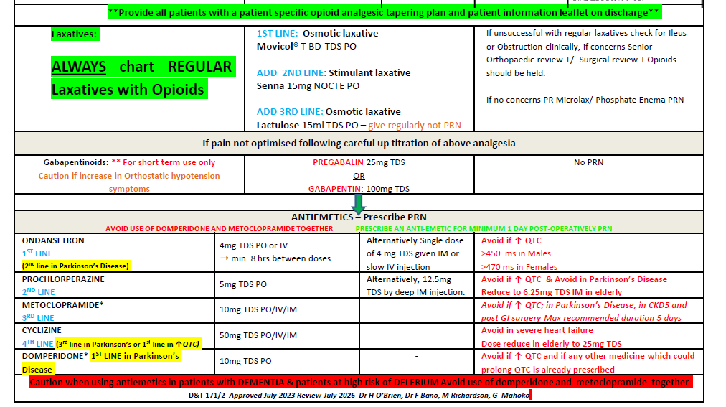
Analgesia Prescribing Guideline
Notes:
Orthopaedic Analgesia Prescribing Guideline refers to the prescribing of analgesia and associated prescribing aimed at NCHD’s who prescribe the majority of post-operative analgesia

Slide 9
Opioid
Post-Operative Patient Information Leaflet
Patient satisfaction survey
Pre and Post Introduction of Leaflet
Completed Nov & Dec 2022
Notes:
Patient satisfaction survey completed, another piece of work to come out of this project

Slide 10
How did we measure the change in practice?
Baseline Point Prevalence Audit completed 4th July 2022
Proforma audit document developed based on Orthopaedic Analgesia Guideline
Review of:
Kardex
Medical notes
ECG
Laboratory results
Point Prevalence Reaudit
completed 15th November 2022
Notes:
Full review of analgesia and associated prescribing for all patients on the ward at the time of the audit using the Orthopaedic Analgesia Guideline as our reference

Slide 11
Results Baseline Audit July 4th 2022
Medicine Group | No of Patients Prescribed | % of Patients Prescribed | No of Appropriate Prescriptions | % of Appropriate Prescriptions | No of Inappropriate Prescriptions | % of Inappropriate Prescriptions | Interventions | Incidents
Paracetamol | 29 | 100% | 27 | 93% | 2 | 7% | 2 | 2
NSAID’s | 4 | 14% | 1 | 25% | 3 | 75% | 3 | 2
Opioids | 26 | 90% | 24 | 77% | 7 | 23% | 7 | 0
Laxatives | 20 | 69% | 28 | 68% | 13 | 32% | 17 | 0
Gabapentenoids | 2 | 7% | 2 | 100% | 0 | 0% | 0 | 0
Antiemetics | 19 | 66% | 18 | 95% | 1 | 5% | 1 | 0

Slide 12
Recommendations from Baseline Audit
Opioids
Only Short acting Opioids regular and PRN for patients ≥ 65 years​
Short duration opioid discharge prescriptions
Laxatives
Prescribe regular laxatives to all patients prescribed opioids
Lactulose to always be prescribed as regular
NSAID’s
Avoid NSAID’s in patients ≥ 65 years

Slide 13
Action Plan
Education
Education sessions held on the ward
Available daily initially, then reduced frequency
Meetings with Stakeholders
Anaesthetics
Orthopaedic Surgeons
Presentation of July Audit results at Journal Clubs & Education Sessions
Accessible Information
A2 posters for the Opioid Conversion table and the Analgesia Guideline were printed
Clinical Room
Central Administration Area
Local Electronic Database

Slide 14
Reaudit November 15th 2022
Medicine Group | No of Patients Prescribed | % of Patients Prescribed | No of Appropriate Prescriptions | % of Appropriate Prescriptions | No of Inappropriate Prescriptions | % of Inappropriate Prescriptions | Interventions | Incidents
Paracetamol | 26 (27 Rx’s) | 93% | 20 | 74% | 7 | 26% | 7 | 1
NSAID’s | 6 | 21% | 5 | 83% | 1 | 17% | 2 | 0
Opioids | 26 (35 Rx’s) | 93% | 28 | 80% | 7 | 20% | 7 | 0
Laxatives | 24 (54Rx’s) | 86% | 40 | 74% | 14 | 26% | 14 | 0
Gabapentenoids | 7 | 25% | 7 | 100% | 0 | 0 | 0 | 0
Antiemetics | 21 (36Rx’s) | 75% | 33 | 91% | 3 | 9% | 3 | 0
Notes:
Using same Audit proforma as July 4th to enable direct comparison

Slide 15
Audit and Reaudit Demographic
Parameter: | 4th July 2022 | 15th November 2022
Number of Patients | 29 | 28
Mean Age | 68 years | 68 years
Mean Weight | 73kg | 74kg
Injury Type:
Hip Related | 41% | 56%

Slide 16
Prescribing Analysis of Audit and Reaudit
Parameter: | July 2022 | November 2022
No opioid naïve patients ≥65 years to be prescribed a long-acting opioid | 15% | 0
Patients ≤4 days post-op to be prescribed a regular and PRN short acting opioid | 65% | 93%
All patients prescribed an opioid to be prescribed at least one regular laxative | 73% | 92%
Lactulose to be charted as regular not PRN | 75% | 91%
Avoid inappropriate NSAID’s in patients ≥65 years old | 75% | 17%
Paracetamol to be dose adjusted for weight ≤50kg and impaired hepatic function | 93% | 74%
Anti-emetics to be prescribed taking into account of ↑QTc and Parkinson’s disease | 95% | 91%

Slide 17
How has the project evolved:
General Surgery Post-Operative Analgesia Guideline Developed
Developed working relationship with Physiotherapy
Joint Research
Joint Education
Reaudit of patients from 2022
Mobility: 30% improvement in post-operative patient mobility
Length of Stay: reduction in LOS for Hip related injuries
Development of Version 2 of Opioid Conversion Chart and Orthopaedic
Post-Operative Analgesia Prescribing Guideline

Slide 18
References:
Ferris, H., Brent, L. and Coughlan, T. (2020) Early mobilisation reduces the risk of in-hospital mortality following hip fracture. European Geriatric Medicine, 11(4), pp. 527-533.
Ferris, H., Brent, L., Sorensen, J., Ahern, E. and Coughlan, T., 2021. Discharge destination after hip fracture: findings from the Irish hip fracture database. European geriatric medicine, pp.1-10.
National Office of Clinical Audit (2019) Irish Hip Fracture Database National Report 2018. Dublin: National Office of Clinical Audit.
National Office of Clinical Audit, (2021) COVID-19 report 2.0: Service impact from COVID-19: Analysis based on Irish Hip Fracture Database June 2019-August 2020. Dublin: National Office of Clinical Audit.
GUIDANCE FOR OPIOID PRESCRIBING FOR ACUTE NONCANCER PAIN, POSTOPERATIVE PAIN & POSTPROCEDURE PAIN HSE Jan 2022 https://msurgery.ie/wp-content/uploads/2022/02/Opioid-guidance-HSE-1.3-CDI-Final.pdf
Our Lady’s Hospice Harold’s Cross https://olh.ie/wpcontent/uploads/2019/01/Opioid-Conversion-Chart-2018.pdf
Renal Drug Database https://renaldrugdatabase.com/
Pharmacological Management of Cancer Pain in Adults, National Clinical Effectiveness Committee Nov 2015 https://www.gov.ie/en/collection/eec97d-pharmacological-management-of-cancer-pain-in-adults/
Mellar et al 92020)Tapering opioids: a comprehensive qualitative review http://apm.amegroups.com/article/view/34860/29324
WHO Analgesic Ladder Aabha A. Anekar; Marco Cascella. May 17, 2020. https://www.ncbi.nlm.nih.gov/books/NBK554435 /
Controlled-release opioids cause harm and should be avoided in management of postoperative pain in opioid naïve patients British Journal of Anaesthesia Editorial October 19, 2018 https://doi.org/10.1016/j.bja.2018.09.005 https://bjanaesthesia.org/article/S0007-0912(18)30711-6/abstrac t
Management of Post-operative Nausea and Vomiting (PONV) Greater Glasgow and Clyde(GGC) NHS Medicines Adult Therapeutics Handbook November 2020 https://handbook.ggcmedicines.org.uk/guidelines/pain-post-operative-nausea-and-vomiting-and-palliative-care-symptoms/management-of-postoperative-nausea-and-vomiting-ponv/
Pathophysiology and management of opioid-induced constipation: European expert consensus statement by Adam D; Asbjørn M Drewes; Giuseppe Chiarioni; Roberto De Giorgio; Tony O’Brien; Bart Morlion and Jan Tack. United European Gastroenterology Journal 2019, Vol. 7(1) 7–20 https://journals.sagepub.com/doi/pdf/10.1177/2050640618818305
Considerations for the inpatient management of Parkinson’s disease The Pharmaceutical Journal 20 March 2020 By Maria Nawaz & Oyinkansola Close https://pharmaceutical-journal.com/article/ld/considerations-for-the-inpatient-management-of-parkinsons-disease

Slide 19
Better Analgesia Prescribing Leads to Better Patient Outcomes
Thank You
Questions

