Slide 1
Elimination of Hospital Acquired Clostridioides difficile in a HSE Model 3 Acute Hospital Tipperary University Hospital Clostridioides difficile Quality Improvement Team Audrey O’Reilly (Pharmacy), Sumera Bashir (Registrar), Elaine Egan (Patient Safety Strategy Coordinator SSWHG)

Slide 2
AIM: To reduce the incidence of HA CDI in medical patients from 20 patients in 2022 to 1 or less new cases per month in a six month period from 01 Jan 2023 to 30 June 2023

Slide 3
Use of QI tools to Analyse the Problem
Pareto Chart
Stakeholder Map
Process Maps
Fishbone Diagram
Driver Diagrams
Measurement Plan

Slide 4
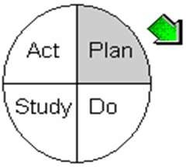
Model for Improvement: PDSA Cycles
PDSA 01
Task- Task-related
Prediction: There is poor documentation regarding indication, review and duration of antibiotics prescribed.
Plan: Establish baseline data Do: Retrospective chart review of known HA CDI June 2022 – Dec 2022
Study: Display results bar chart Act: Present findings to Hospital Management team & identify consultant to work with us
Changes made: Convene a stakeholder meeting with Geriatric consultant
PDSA 02
Develop a Change
Prediction: Consultant engagement will help identify change ideas for improvement
Plan: Feedback on baseline audit results Do: Look for suggestions for improvement
Study: Clinical Pharmacist to attend ward rounds Act: Pharmacist to commenced ward round on agreed date
As predicted: Feeding back baseline audit results and requesting ideas for solutions was beneficial for buy-in
Changes made: Pharmacist to attend ward round for 2 weeks staring on 11.01.23 Dates agreed for Pharmacist to attend ward rounds
PDSA 03
Implement a change and test a change
Prediction: Pharmacist attending consultant –led ward round will prompt the team to review antibiotics prescribed.
Plan: Pharmacist to attend ward round twice a week from 11.01.23 Do: Prompt the team to review antibiotics prescribed
Study: Retrospective review of medical charts for 2 weeks from 11.01.23 Act: Schedule stakeholder group meeting 31.01.23
As predicted: it was found an improvement of indication, of review/plan for antibiotics and durations were seen
PDSA 04
Further develop a change
Prediction: Reporting back to stakeholders will identify that further change can create more improvement i.e. a new PDSA
Plan: Scheduled a meeting with stakeholder group Do: Stakeholder meeting held on 31.01.23
Study: Review & discussion of audit results Act: Senior person on the rounds to hold med chart in their hand & review abx section
As predicted: on going engagement from consultant led team to further improve process measure results

Slide 5
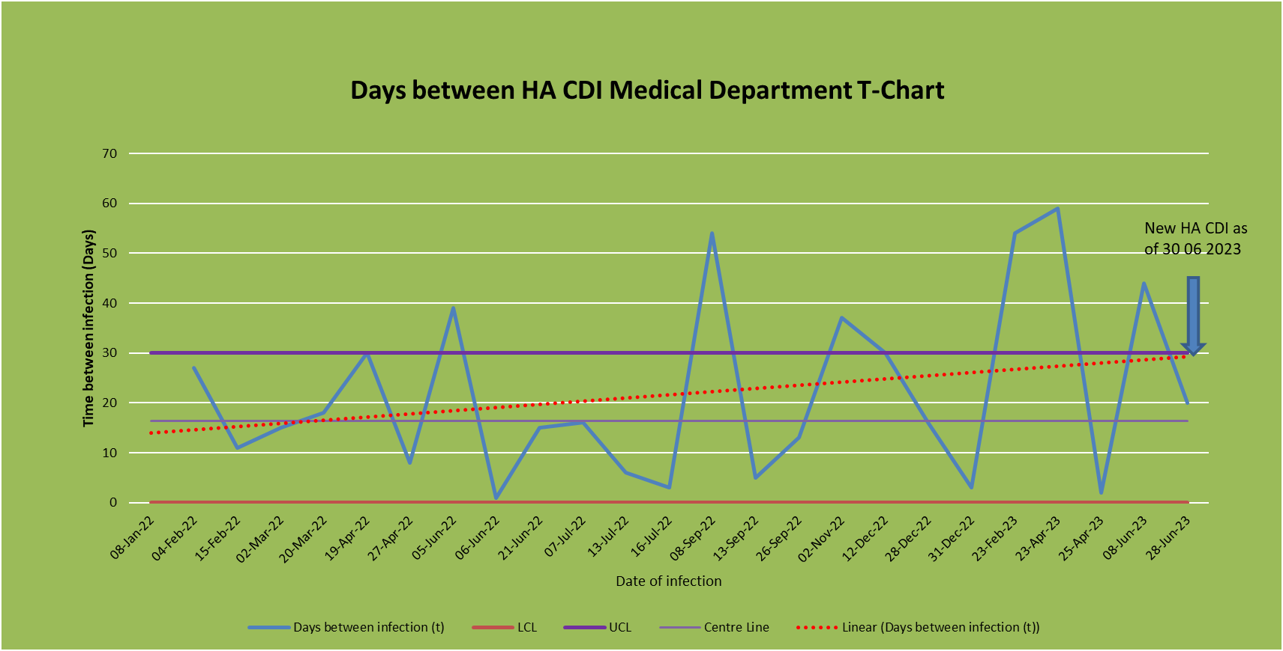
Measuring that change makes a difference
Sustainable QI:
Reduced HA CDI in TippUH also results in reduced usage and disposal costs with resources such as aprons, gloves, masks, toiletries, bed linen, packaging of antimicrobials, plastic containers, fluid bags, syringes and IV giving sets.
Cost Savings:
A basic cost analysis was undertaken using findings from an Irish study in a Level 4 hospital (Ryan et al 2017) & taking cost of pharmacist time in to account, indicates savings to TippUH of approx €46,600 for Jan – June 2023.

Slide 6
Engaging Patients and Family and Our Staff
Working with TippUH Patients’ Representatives Group – meaningful engagement with follow through

Slide 7
Acknowledgements
Project sponsors in Tipperary University Hospital:
Maria Barry, Hospital Manager & Dr A Majeed, Clinical Director
All stakeholders and collaborators in Tipperary University Hospital
RCPI Faculty including John Fitzsimons, John Brennan, John Quinn, Peter Lachman

