Slide 1
Medicines optimisation for community-dwelling people with multimorbidity
Prof Emma Wallace PhD MICGP
GP, Parklands General Practice, Cork Chair of General Practice, UCC
HRB Emerging Clinician Scientist

Slide 2
Overview
General Practice: multimorbidity
Research interests
Problematic polypharmacy & medicines optimisation
Adverse drug reactions and prescribing cascades
Policy developments

Slide 3
Patient story
58 years attending general practice
Type 2 Diabetes
Coronary heart disease
Hypertension
Atrial fibrillation
COPD
Chronic back pain
Depression
Hypothyroidism

Slide 4
Patient story
Aspirin
Metformin
Glicazide
Pioglitazone
Salbutamol
Becotide
Levothyroxine
Citalopram
Lisinopril
Amlodopine
Atenolol
Furosemide
Gabapentin
Omeprazole
Co-codamol

Slide 5
Consultations
Blood pressure control
Kidney function
Secondary prevention
Smoking
Medications
Sole earner
Manual job
Support ageing parents
Back pain
Mood

Slide 6
Research evidence in Primary Care
Most illness presents and is managed in primary care
Acute illness, long-term health conditions management, disease prevention, all ages
Gatekeeping role to secondary care
Complexity and multimorbidity increasing
50% of all GP consults
Health system designed around single body systems
Disease-specific clinical guidelines

Slide 7
Multimorbidity: prevalence
Barnett K, Mercer SW, Norbury M et al. Epidemiology of multimorbidity and implications for health care, research, and medical education: a cross-sectional study. Lancet. 2012 Jul 7;380(9836):37-43.

Slide 8
Multimorbidity: socio-economic disadvantage
Barnett K, Mercer SW, Norbury M et al. Epidemiology of multimorbidity and implications for health care, research, and medical education: a cross-sectional study. Lancet. 2012 Jul 7;380(9836):37-43.

Slide 9
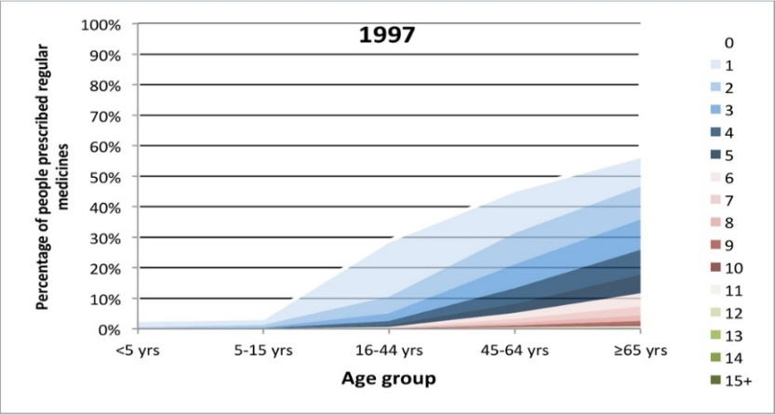
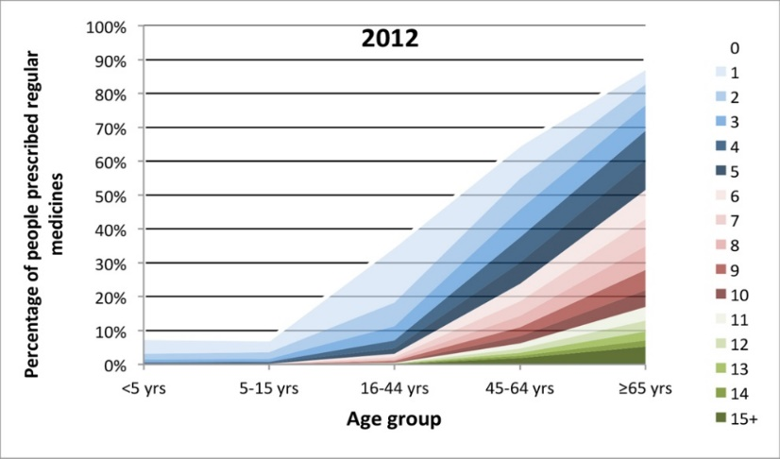
Multimorbidity and Polypharmacy: Irish data
66% aged over 50 years live with at least two long-term health conditions¹
10+ meds (complex polypharmacy)²
45–64 years 0.8%-8.3%
≥65 years 1.5%-21.9%
Glynn LG, Valderas JM, Healy P, et al. The prevalence of multimorbidity in primary care and its effect on health care utilization and cost. Fam Pract. 2011 Oct;28(5):516-23.
Moriarty F, Hardy C, Bennett K, et al. Trends and interaction of polypharmacy and potentially inappropriate prescribing in primary care over 15 years in Ireland. BMJ Open 2015;5:e008656.

Slide 10
Multimorbidity: adverse health outcomes
Systematic review evidence ^{1,2}
Associated with;
Poorer health-related quality of life
Functional decline
Increased treatment burden
Increased healthcare use
Premature death
Increased healthcare costs
France EF, Wyke S, Gunn JM et al. Multimorbidity in primary care: a systematic review of prospective cohort studies. BJGP 2012; 62 (597): e297-e307.
Tran PB, Kazibwe J, Nikolaidis GF et al. Costs of multimorbidity: a systematic review and meta-analyses. BMC Med 2022; 20, 234.

Slide 11
Multimorbidity: Applying clinical guidelines
Hypothetical 62-year-old female ¹
Ischaemic Heart Disease
Type 2 Diabetes
Osteoarthritis
COPD
Depression
Application of five UK clinical guidelines
1. Hughes LD, McMurdo ME, Guthrie B. Guidelines for people not for diseases: the challenges of applying UK clinical guidelines to people with multimorbidity. Age Ageing 2013;42:62-9.

Slide 12
Multimorbidity: Applying clinical guidelines
Prescribed at least 11 medications
Potential for another 10 medications depending on disease progression
Advised to engage in at least 9 lifestyle modifications
Attend 8-10 primary care appointments
Attend 8-10 secondary care appointments
Attend multidisciplinary team appointments
e.g. dietician, counselling etc.

Slide 13
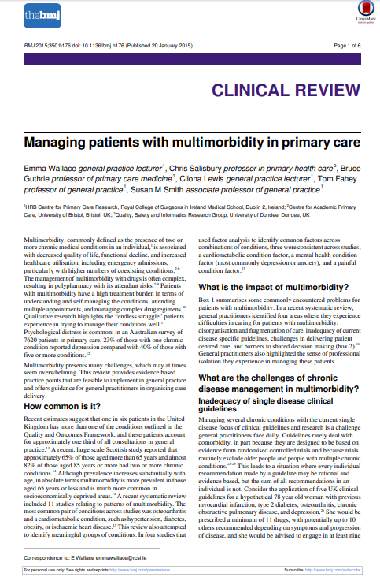
Multimorbidity: management in primary care
Three key challenges:
Disorganisation and fragmentation of care
Delivering patient centred care
Chronic disease management

Slide 14
Disorganisation and fragmentation of care
Identification difficulties
Continuity of care
Relational, information, managerial
Improved preventative measures, reduced preventable admissions
Consultation times
Suboptimal communication

Slide 15
Patient centred care
Shared decision making
Targeting function rather than disease?
Supporting self-management of conditions

Slide 16
Chronic Disease Management
Single disease focus of clinical guidelines
Rarely address multimorbidity
RCTs often exclude patients with multimorbidity
Individual recommendations sensible but sum of all are not
Problematic Polypharmacy
Higher number of medications
Higher risk medication-related harm and emergency admissions

Slide 17
Overview
General Practice: multimorbidity
Research interests
Problematic polypharmacy & medicines optimisation
Adverse drug reactions and prescribing cascades
Policy developments

Slide 18
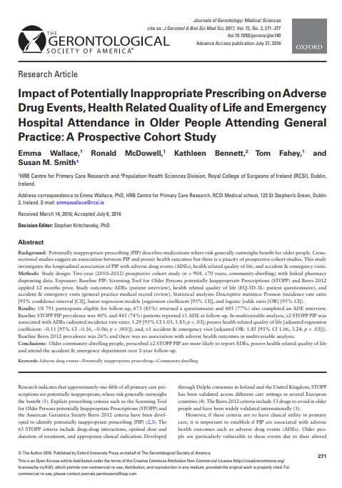
Problematic Polypharmacy: Potentially Inappropriate Prescribing
Two-year prospective cohort study
N=904, 15 general practices, Aged ≥70 years
PIP via STOPP using linked pharmacy claims data
Primary outcome
ADRs over 6 months (nurse-led patient interview)
Secondary outcomes
Health related Quality of Life
Emergency admission and ED visits

Slide 19
Results: Study participants (baseline)
Age: median 77 years (IQR 74, 81)
Gender: Male n=415 (46%)
Deprivation: median 1.49 (IQR −0.6, 3.1)
Number of drug classes: median 6 (IQR 3, 8)
Medication Possession Ratio: median 0.83 (IQR 0.69, 0.91)
Prevalence baseline PIP: 40%

Slide 20
Results: Primary and secondary outcomes
STOPP PIP exposure, regression analysis, adjusted for confounders
Outcomes: ADRs, HRQoL (EQ-5D), A&E visits, emergency admission
 | ADEs ^{ⱡ} adjusted IRR, 95% CI | HRQoL (EQ-5D) ^{ⱡⱡ} adjusted co-efficient, 95% CI | ≥1 A&E visits ^{ⱡⱡⱡ} adjusted OR, 95% CI | ≥1 emergency admission ^{ⱡⱡⱡ} adjusted OR, 95% CI
1 PIP | 0.85 (0.70, 1.03) | -0.002 (-0.04, 0.04) | 1.82 (1.15, 2.89)* | 0.88 (0.59, 1.31)
≥2 PIP | 1.29 (1.03, 1.60)* | -0.11 (-0.16, -0.06)** | 1.85 (1.06, 3.24)* | 1.00 (0.63, 1.61)
^{ⱡ}Adjusted for age, gender, deprivation, education, social class, number of medications, comorbidity, medication adherence
^{ⱡⱡ} Additionally adjusted for vulnerability, social support and depression
^{ⱡⱡⱡ} Additionally adjusted for vulnerability and prior healthcare utilisation
*p<0.05, **p<0.001
Notes:
Eq-5d standardised measure of health status (mobility, self-care, usual activities, pain, anxiety/depression) scored no problems, moderate problems, extreme problems (3 level) , time trade off valuation method using a set of utility values developed based on the UK population, score 0 to 1 with some health states considered worse than death (death=0)Median follow-up eq-5d=0.88 prospective cohort studies clinically important difference for eq-5d is 0.07 (range -0.01, 0.14)
IRR: number of incident cases (ADEs) divided by the population at risk (or person-time at risk). In a cohort study, the relative risk (or IRR) is determined to measure the strength of the association between a factor and a disease. In a cohort study, particularly on the occasion of a logistic regression, we replace the relative risk by the odds ratio if the disease is rare (incidence less than 10%). 25% of patients had one or more emergency admissions, 19% had one or more a+e visits (but v small numbers in two or more PIP and a+e visits group)

Slide 21
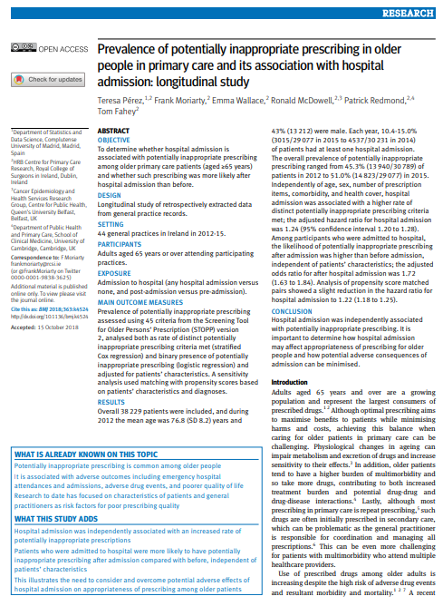
Potentially Inappropriate Prescribing: hospital admission
Longitudinal study of retrospectively extracted data from GP EHRs
44 general practices in Ireland in 2012-15
Adults aged 65 years or over
N=38,229 patients

Slide 22
PIP and hospital admission
Exposure
Admission to hospital (any hospital admission versus none and post-admission versus pre-admission)
Main outcome measure
Prevalence of PIP assessed using STOPP version-2

Slide 23
Results
N=38,229, mean age 76.8 (SD 8.2)
Annually 10.4-15.0% of patients ≥1 hospital admission
PIP prevalence:
45.3% (2012) to 51.0% (2015)
Hospital admission associated with a higher rate of PIP
adjusted HR for hospital admission 1.24 (95% CI 1.20 to 1.28)
Likelihood of PIP after admission was higher than before admission
adjusted OR for after hospital admission 1.72 (95% CI 1.63 to 1.84)

Slide 24
Key findings
Hospital admission independently associated with an increased rate of PIP
Patients admitted to hospital more likely to have PIP after admission compared with before, independent of patient characteristics
Need to consider transitions of care as a time of increased risk

Slide 25
Current Research
HRB Emerging Clinician Scientist Award
Problematic polypharmacy
Different research methodologies
Collaborative multidisciplinary approach
Essential to try to understand complex problems
Potential solutions require different skillsets

Slide 26
Core research team

Slide 27
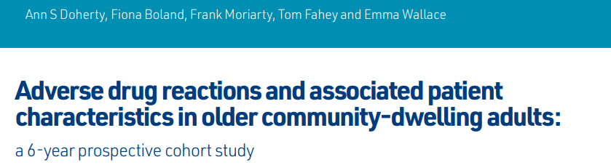
ADRs: General Practice
Prospective cohort study: 6 year follow up
n=592 aged ≥70 years, n=15 general practices
Median age=75 years (IQR 73, 79)
Median drugs=5 (IQR 3, 7)
Cumulative incidence ADRs (via GP EHR manual review)=26.9% (n=159; 211 ADRs)
Majority mild (89.1%), moderate (10.9%)
8 moderate ADRs=3.8% of total: emergency admission
Doherty AS, Boland F, Moriarty F, Fahey T, Wallace E. Adverse drug reactions and associated patient characteristics in older community-dwelling adults: a 6-year prospective cohort study. British Journal of General Practice 23 January 2023; BJGP.2022.0181.

Slide 28
ADRs: General Practice
ADRs independently associated with;
female sex (adjusted OR 1.83, 95% CI 1.17, 2.85; P = 0.008)
5–9 drug classes (adjusted OR 1.81, 95% CI 1.17, 2.82; P = 0.008)
≥10 drug classes (adjusted OR 3.33, 95% CI 1.62, 6.85; P = 0.001)
Medication classes (WHO-ATC system):
Cardiovascular (32.7%)
diuretics, calcium channel blockers, ACEI/ARBs-dry mouth, headache, ankle swelling, dizziness
Neurological system (28.9%)
analgesics (e.g. tramadol)-sedation, SSRI-dizziness

Slide 29
ADRs: General Practice: Summary
ADRs are common in older people
Difficult to diagnose-overlap of symptoms
Females at higher risk than males
Increasing numbers of medications=increased risk of ADRs
Patients taking 10 or more medicines=very increased risk

Slide 30
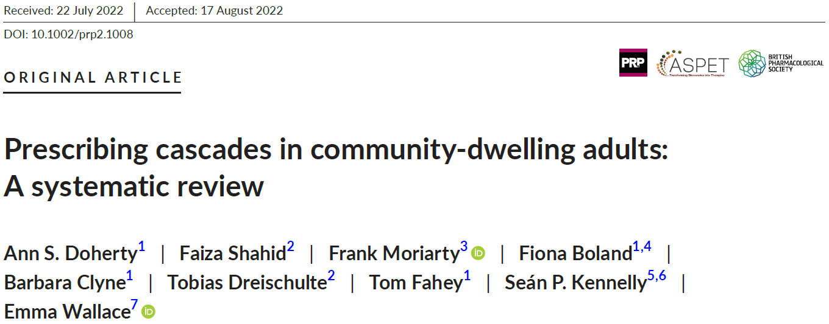
Prescribing cascades Systematic review
Intentional or unintentional
Misattribution of ADR as a symptom or illness can lead to the prescribing of additional medication
Aim: to identify prescribing cascades in community‐dwelling adults
Systematic review with narrative synthesis
Doherty AS, Shahid F, Moriarty F, Boland F, Clyne B, Dreischulte T, Fahey T, Kennelly SP, Wallace E. Prescribing cascades in community-dwelling adults: A systematic review. Pharmacol Res Perspect. 2022 Oct;10(5):e01008. doi: 10.1002/prp2.1008.

Slide 31
Prescribing cascades: Results
N=101 studies (sample sizes: n=126 to 11, 593, 989 participants)
N=15 studies older adult study populations
78 studies reported a potential prescribing cascade
Calcium channel blockers ►pedal oedema► loop diuretic
Amiodarone ►hypothyroidism► levothyroxine
Antipsychotic ►Parkinsonism ► anti‐Parkinson drug
Acetylcholinesterase inhibitor ► urinary incontinence ► urinary incontinence drugs
Occurred 3 months-1 year following initial medication initiation

Slide 32
Prescribing cascades: Systematic review: summary
Prescribing cascades occur for several commonly prescribed medicines in primary care
ThinkCascades recently published
ADRs should be included in the differential diagnosis for patients presenting with new symptoms
older adults
new medication in the preceding 12 months
non-specific symptoms challenging

Slide 33
Overview
General Practice: multimorbidity
Research interests
Problematic polypharmacy & medicines optimisation
Adverse drug reactions and prescribing cascades
Policy developments

Slide 34
Policy developments: general practice
Structured chronic disease management is now well established
High satisfaction rates from patients and providers
ICGP/HSE GP clinical leads
Opportunistic case finding
Enhanced opportunities for screening and prevention of disease

Slide 35
Policy developments
Significant HSE investment in direct primary care diagnostics access
Enhanced community care-timely access to integrated care hubs and community-based therapy services
iSympathy project examining the role of pharmacist-led medication reviews in primary care
Interim analysis published

Slide 36
Summary
Multimorbidity and problematic polypharmacy are common
ADRs are common and can be difficult to diagnose
Prescribing cascades
Transitions of care: increased risk
Policy developments

Slide 37
Thank you!

