Slide 1


Exploring methods to reduce high-alert medication incidents
in Galway University Hospitals
Diana Hogan-Murphy, Chief 2 Pharmacist Medication Safety
Galway University Hospitals
.
Irish Medication Safety Network Conference UCC 24/11/23

Slide 2
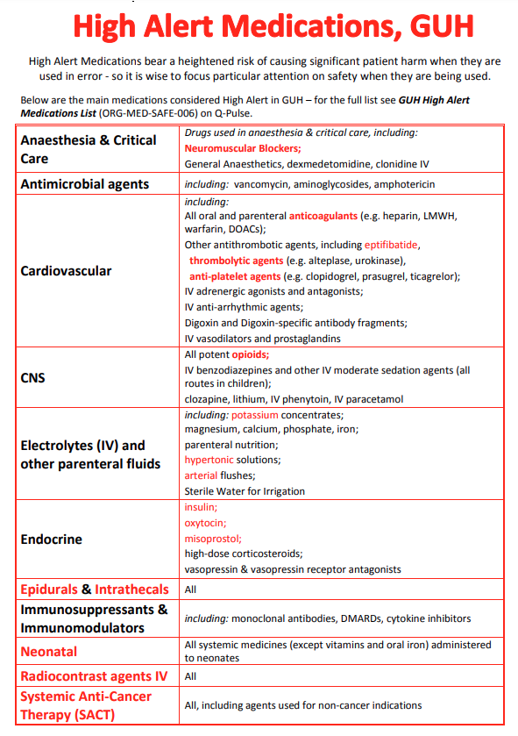
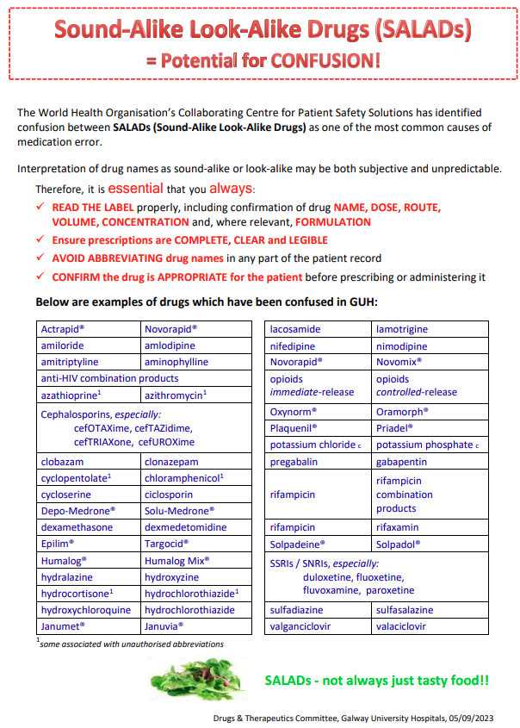
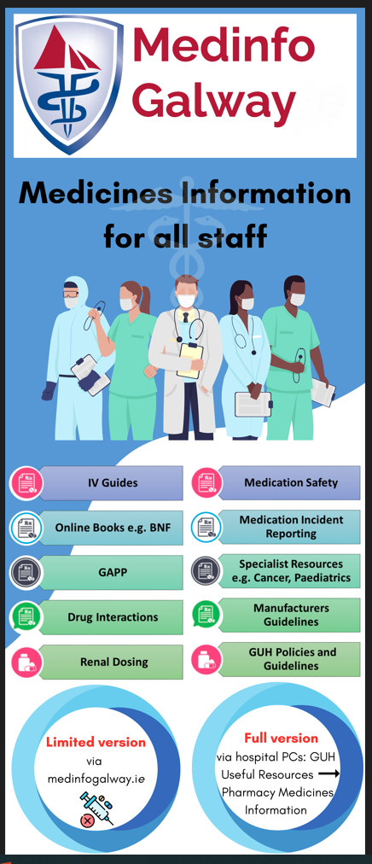
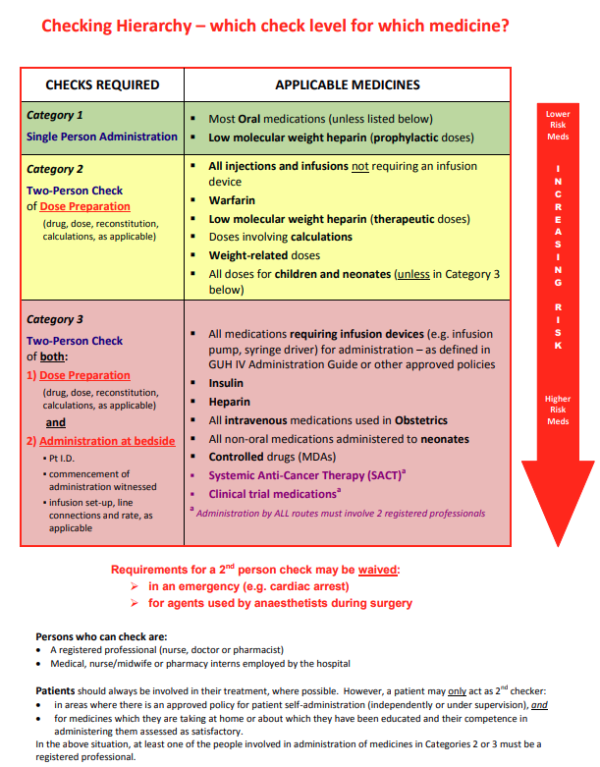
Medication Safety in GUH
Ensure the safest possible environment for patients and staff at all stages of the medication use process
Focus on governance, interventions, and education
Medication Safety Subgroup
Meetings
Quality and Patient Safety Committee Meetings
Directorate Meetings
Group Clinical Director Meetings
Drugs and Therapeutic Committee Meetings

Slide 3


Aims
Explore methods to reduce high-alert medication errors in GUH
Identify and develop agreed QI initiatives to optimise patient care

Slide 4
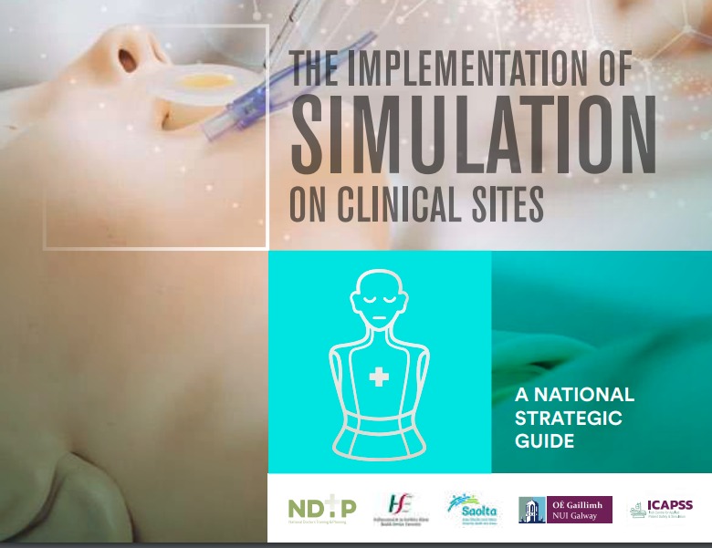
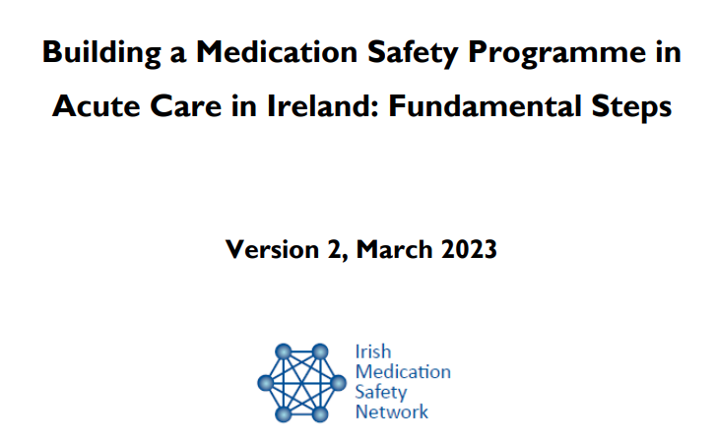
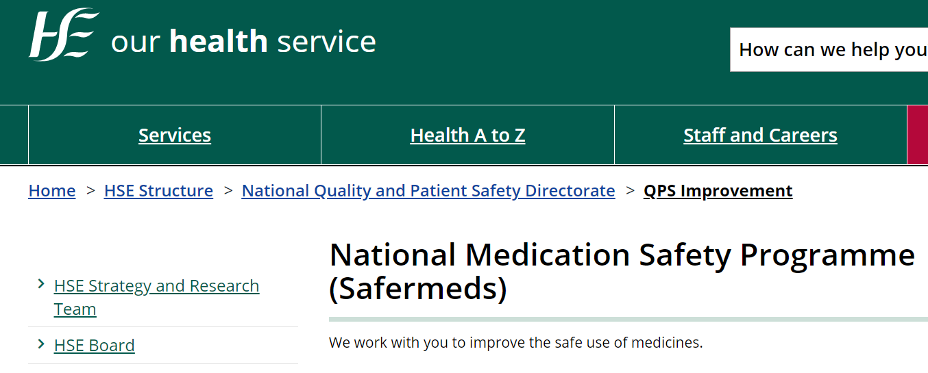
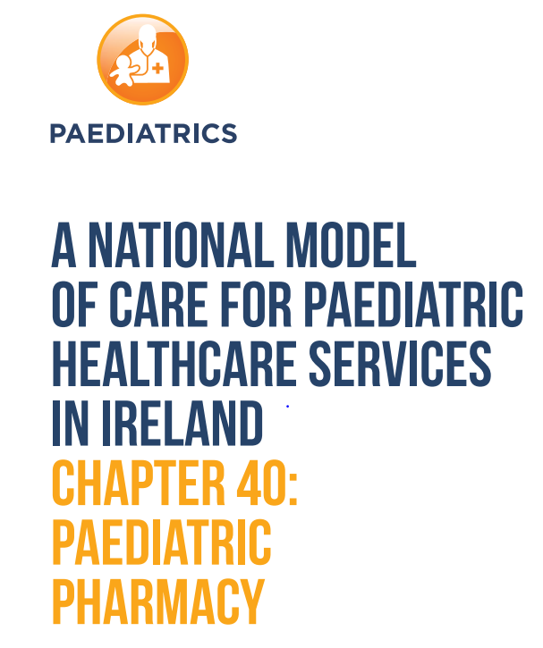
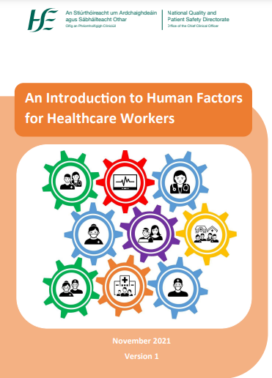
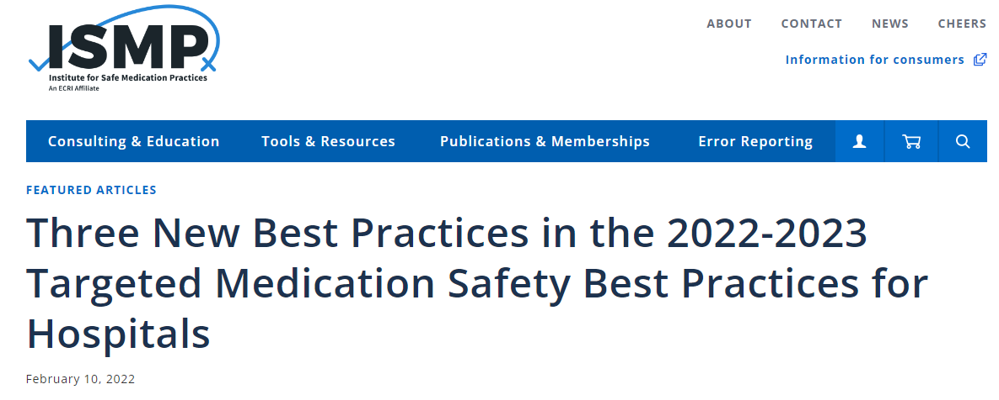
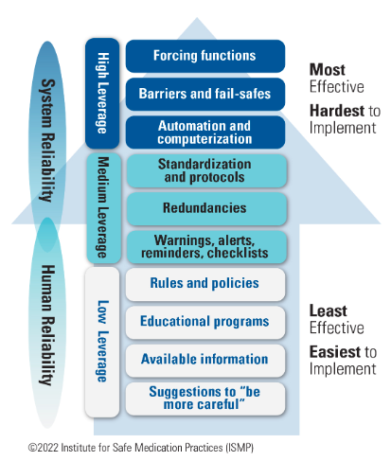
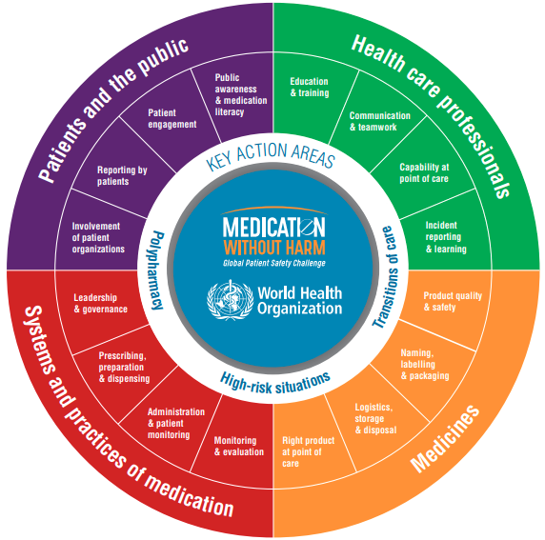
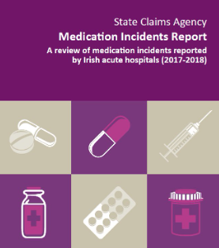


Methods
1
01
Literature review conducted Q3 2022 to identify best methods to reduce high-alert medication incidents
2
02
E-learning approaches increasingly recognised as potential complementary strategies to promote safe use

Slide 5
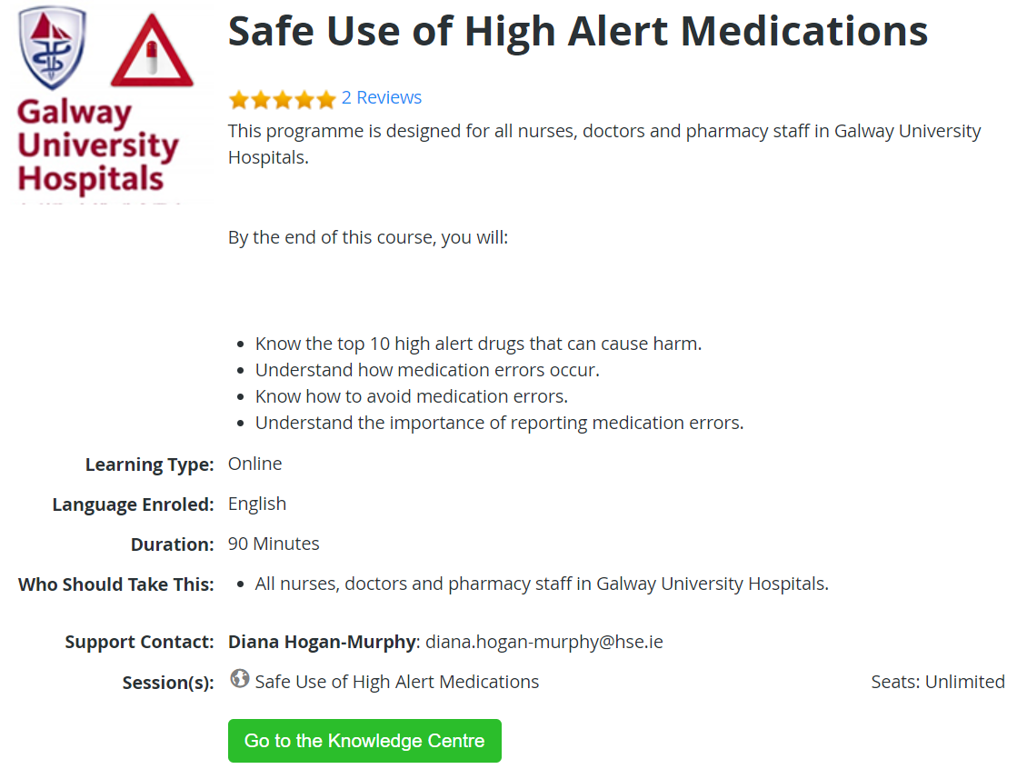

Outcome

Slide 6

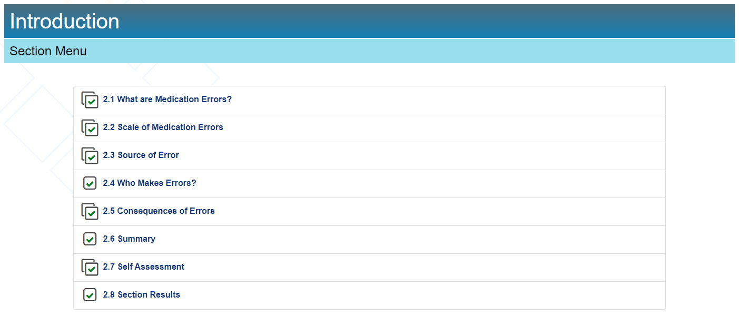
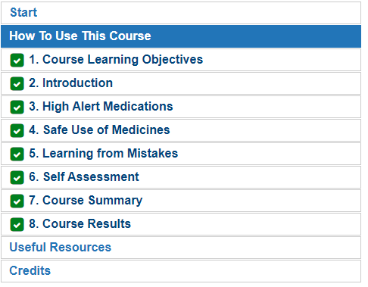
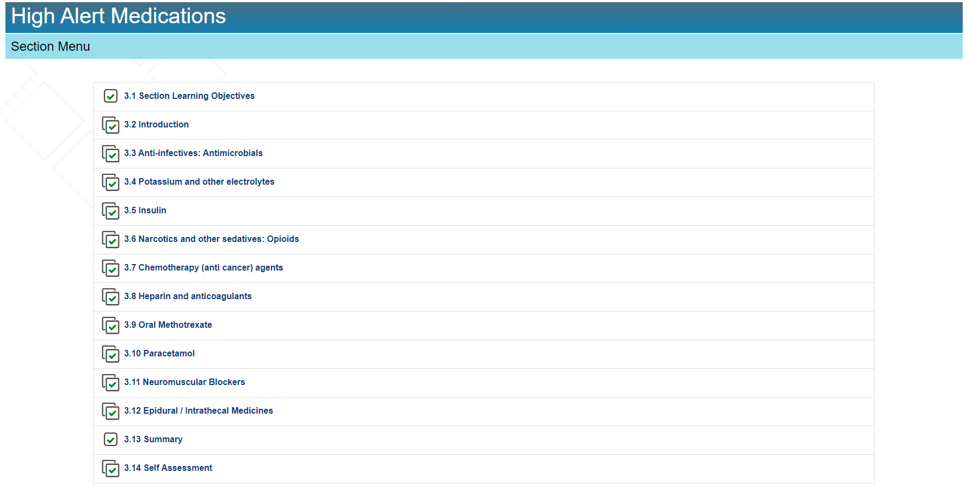

Slide 7
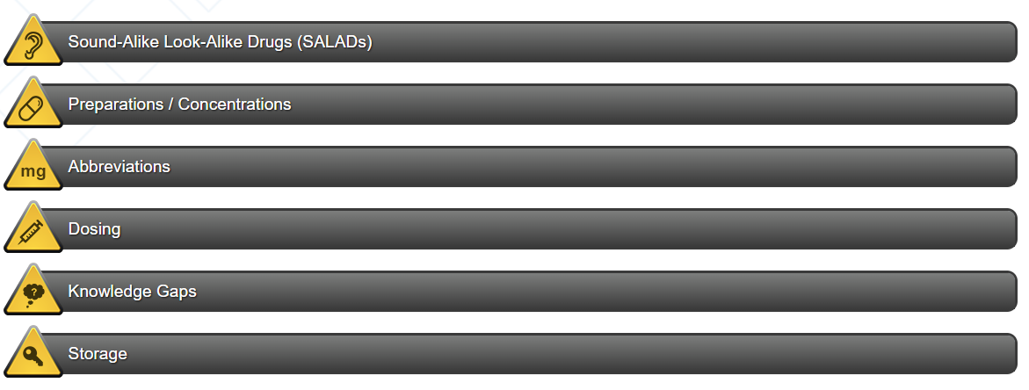
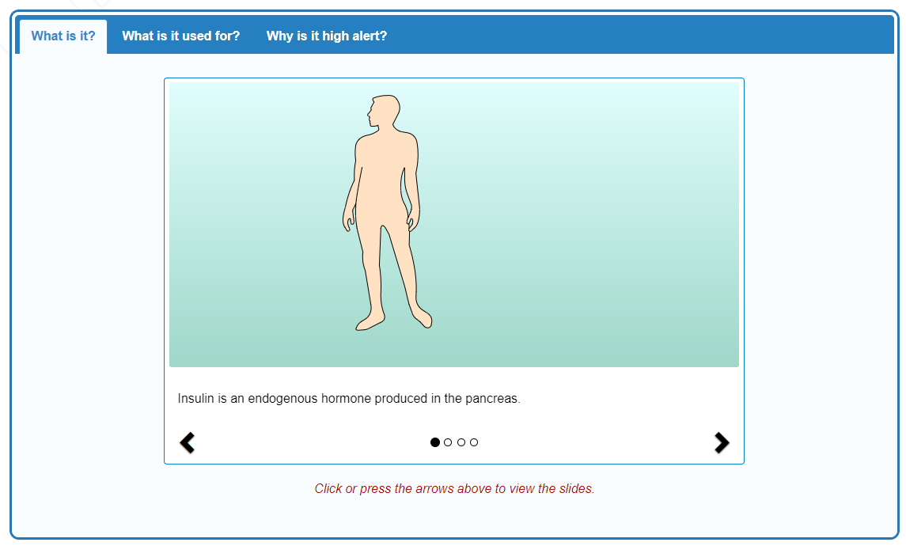
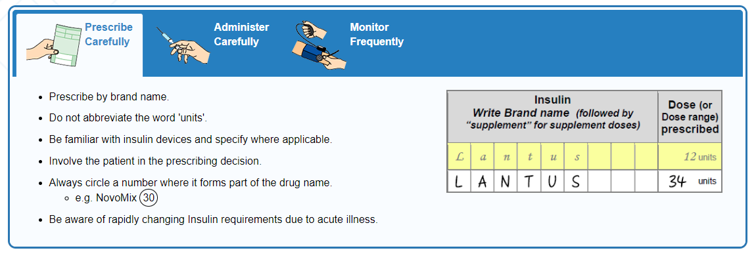
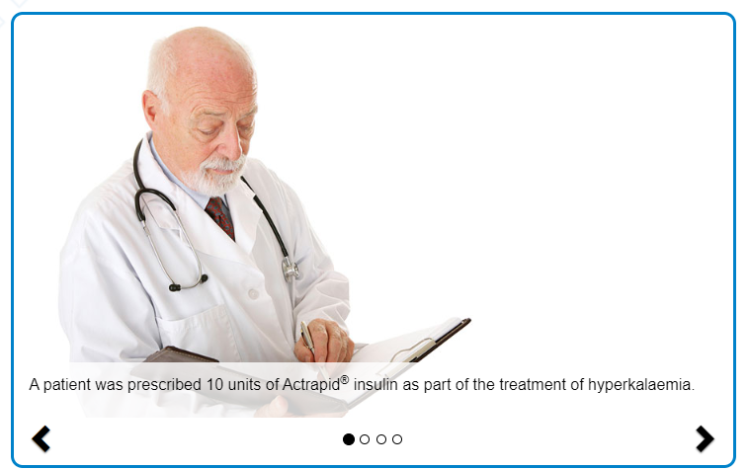

Slide 8
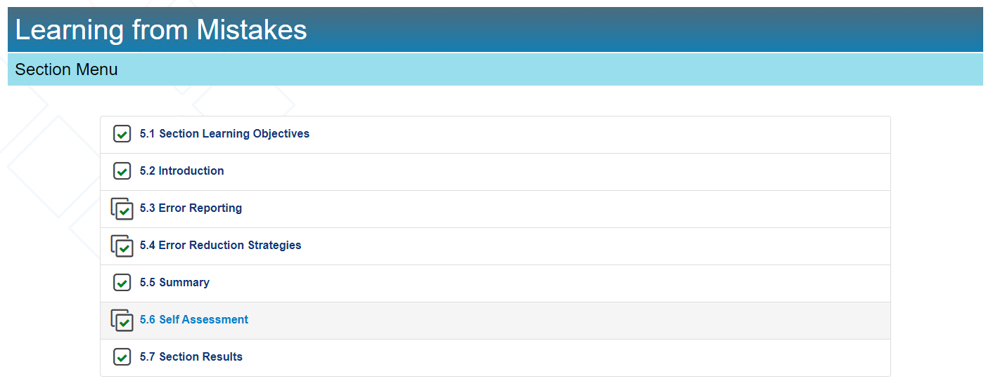
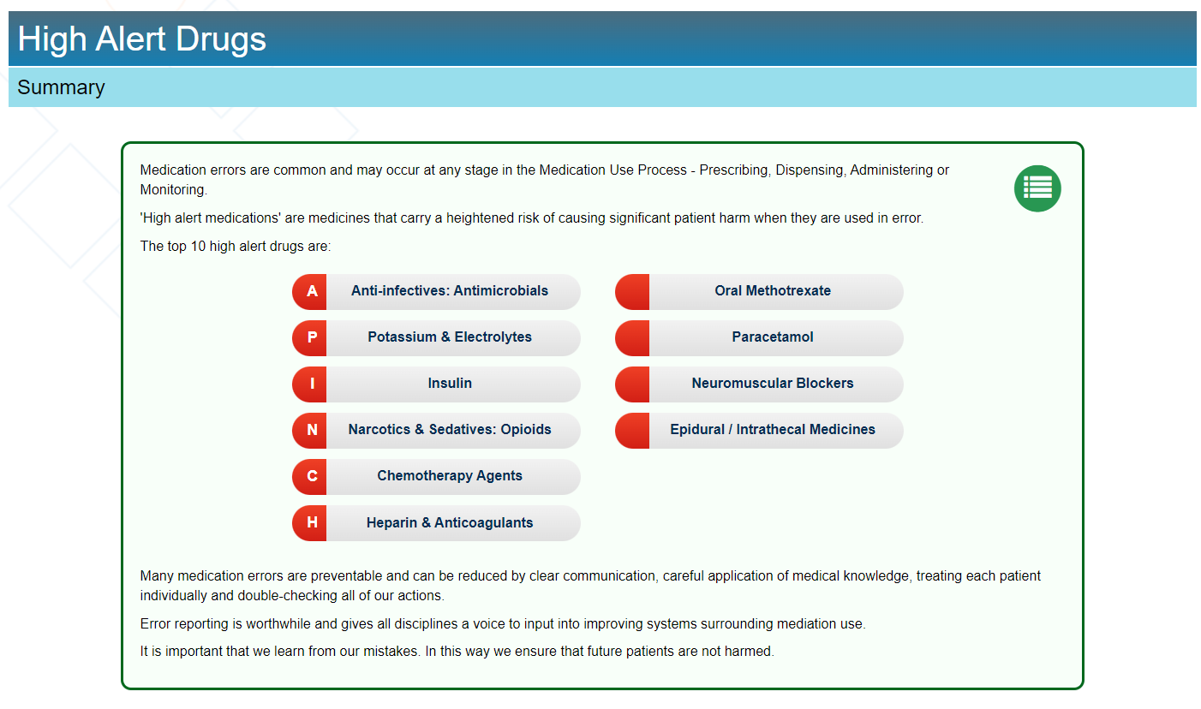
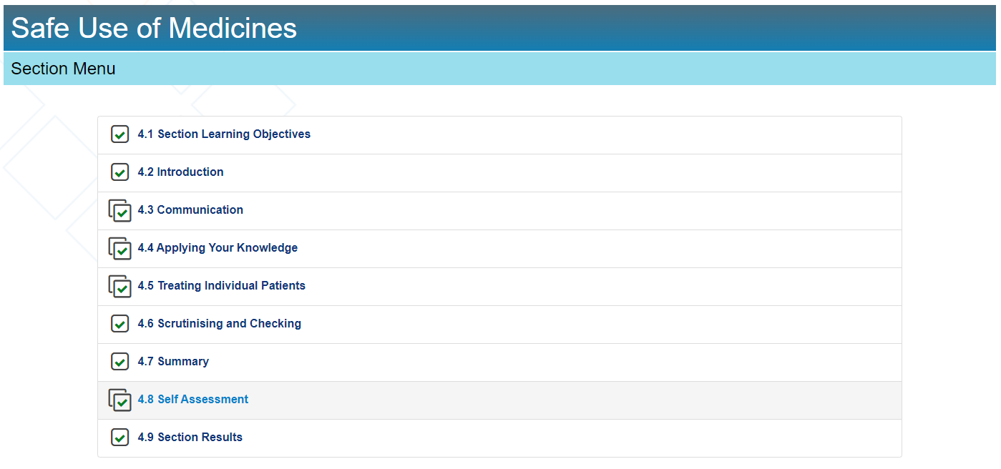

Slide 9


Results
Uptake
Incident reporting
Feedback
Transferability

Slide 10
Thank you
Acknowledgements
Learning Industries Ltd
Acknowledgements
Prof John Given, Prof Michael Conall Dennedy, Prof Laurence Egan
Acknowledgements
Pharmacy, nursing, medical and senior management support

Slide 11
Questions?
Smarter technology for a safer tomorrow
QI QI QI….
Nurture a positive culture | listen | learn | proactive | respond | open disclosure |
patient engagement | patient safety | workforce safety
Everyone has a role to play in medication safety

