Slide 1
Hospital Medication Management System (HMMS) & Medication Safety
ISMN Conference 2023
Muriel Pate & Nina Acosta
on behalf of
Fionnuala King & Elmarie Cottrell
HSE Acute Hospital Drug Management Programme (AHDMP)

Slide 2
What is HMMS?
HMMS is the national project to replace Hospital Pharmacy Departments current legacy software
HMMS will deliver Pharmacy and eDischarge software to acute and non-acute hospitals
HMMS will also become the platform to support electronic prescribing and electronic medicines administration for hospitals which wish to avail of it.
The software will be configured based on the requirements of Irish hospitals
The database will utilise standardised master data and reference sets
Patient demographic information enriched with the Individual Health Identifier (IHI)
The HMMS National Office will support ongoing service contracts, business support, patches, updates, system enhancements and user licenses
NSP 2023: Key Objective
“Support the safe and cost-effective use of medicines through health technology and management processes for new medicines and the ongoing clinical management and monitoring, ensuring equity in the provision of existing and emerging medicines / therapies”
HMMS will be offered to all publically funded acute and non-acute hospital sites in Ireland that are currently paying Pharmacy software license fees

Slide 3
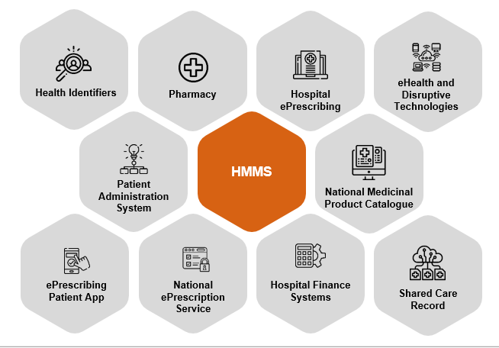
HMMS and the eHealth Ecosystem
Notes:
Putting patient safety as the core piece of what we want to achieve will mean the other pieces will fall into place.

Slide 4
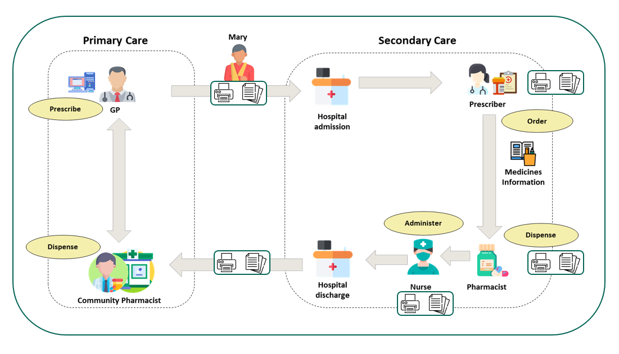
Current Patient Journey
Notes:
Return to Mary and her journey.
NMPC supports the systems and services with information source to allow semantic interoperability.

Slide 5
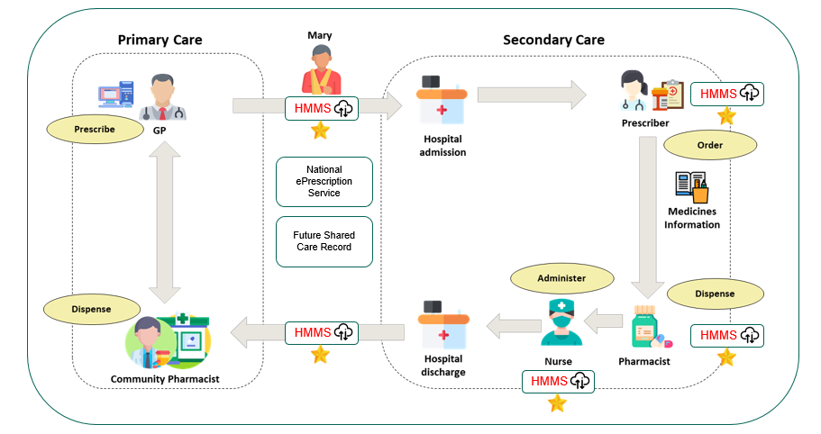
Future Patient Journey
Notes:
Return to Mary and her journey.
NMPC supports the systems and services with information source to allow semantic interoperability.

Slide 6
HMMS Benefits
Semantic interoperability with standardised datasets
Supports indication based prescribing and Activity Based Funding
Improved Patient Safety
Modern tool for 21st century workforce
Compatible with Robots, ADCs, EHR, IHI
Modern tool for eHealth efficiencies
Compatible with Robots, ADCs, EHR, IHI

Slide 7
“on the shoulders of giants, I can see further”
Notes:
Medication safety has been key to the work at every stage of the process
Many in the room have been part of advisory groups, implementation groups, workshops – it would not have been possible to achieve what has been done to date without that really valuable input and it will continue to be so important as the HMMS project continues to develop, particularly the EPMA component.

Slide 8
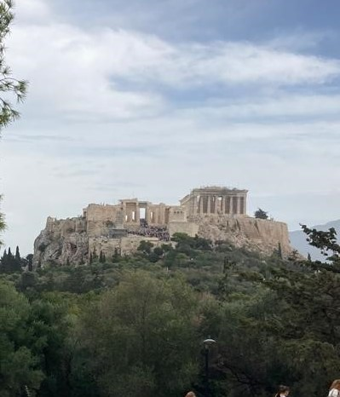
Notes:
Putting patient safety as the core piece of what we want to achieve will mean the other pieces will fall into place.
Importance of good foundations – Perthenon in Athens – completed in 438BC
Massive limestone foundations – some up to 12 metres deep – survived millennia, several major attacks and earthquakes
Those foundations allowed the Parthenon – Temple dedicated to Athena, patron Goddess of Athens, to be built in just 9 years
Athena was chosen over her male counterpart Poseiden, as she was known for her wisdom, courage and ability to create useful things.

Slide 9
HMMS System Configuration and Data Governance
HMMS Steering Board
HMMS Implementation Board
Stakeholder workshops
HMMS Data Protection Impact Assessment
HMMS Project Sponsors

Slide 10
HMMS Key Stakeholder Boards and Working Groups
Advisory Board
Project Board
(pre-contracting)
Procurement Evaluation Group (PEG)
Steering Group
Implementation Board
Membership nominations from Acute Hospital Pharmacy Departments & CHO Facilities Pharmacy Department via HG & CHO leadership
Eleven Pharmacy Departments members including Acute, CHO, Section 38s
Objectives: Specification of Requirements
Members represented the Project Sponsors & Acute & non-Acute Hospital Chief Pharmacists
Objectives:
Approve HMMS procurement approach
Agree Phase 1 site selection
Management oversight of the HMMS tender process
Approve HMMS Specification of Requirements
Ensure that engagement is achieved in the wider organisation
Agree subsequent lot roll-out approach and sequencing of sites
Dissolved once contract signed with preferred vendor
Members were future users of HMMS and contributed as Subject Matter Experts.
Phase 1 Chief Pharmacists were requested to participate as members
Six Chief Pharmacists from Pharmacy Departments – Acute, CHO , Section 38s
Objectives: Preferred Vendor selection
Members are future users of HMMS and Subject Matter Experts
Chief Pharmacists members are not from Phase 1 sites
Three Chief Pharmacists from Pharmacy Departments – Acute, CHO, Section 38s
Objectives:
To provide strategic direction and decision making in the implementation of the project deliverables nationally
To monitor and have oversight of the implementation of the HMMS system
To ensure compliance with relevant HSE legislative & regulatory frameworks.
Members are future users of HMMS and subject matter experts. Phase 1 Chief Pharmacists were requested to participate as members
Seven Chief Pharmacists from Pharmacy Departments – Acute, CHO , Section 38s
Objectives:
To ensure that user interests are represented
To oversee establishment and output of the working groups and to adjudicate on output where necessary
To provide leadership and support local project teams on the implementation of HMMS across all sites
To assess, categorise and propose mitigation for risks identified during the project
Notes:
Steering Group – Eileen Relihan is a medication safety representative on that group – diverse group, wider context
Implementation Board – comprised of representatitves from hospitals which will be going live in phase 1
HMMS Advisory Group will act as subject matter experts to support procurement, configuration and implementation of HMMS in a legislatively complaint manner.
High level user requirements
Reviewed against previous work to define Medication Management Component of Acute EHR (2017)
Could Have
Should Have
Must Have
Procurement Evaluation Group: HMMS PEG will act as subject matter experts to support the tender submission and review and selection of a preferred vendor for HMMS in a legislatively complaint manner. Evaluation via structured template:
Approach and Methodology
Plans and Progress
Go live and early support
Core Requirements (132)
E.g. The system must include a patient weight field. It may be optional to use and should have an associated timestamp for when the weight was recorded in HMMS.

Slide 11
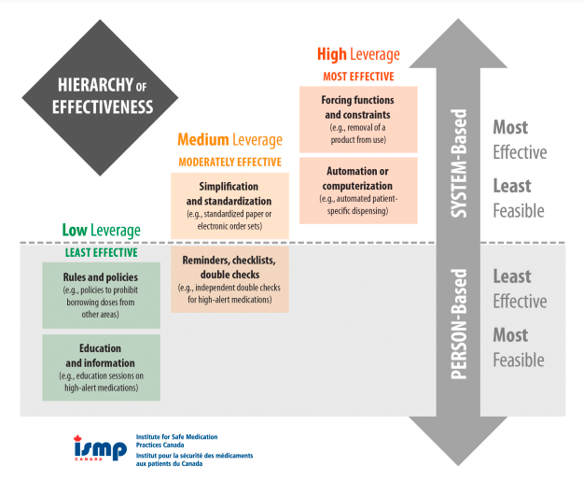
ISMP - Hierarchy of Effectiveness

Slide 12
HMMS - System Based Medication Safety

Slide 13
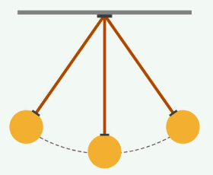
HMMS Single Patient Record
Application supports a single national patient record
Single view of patients national medication history
Patient record created at common or national level
Patient record registered to the required Locality

Slide 14
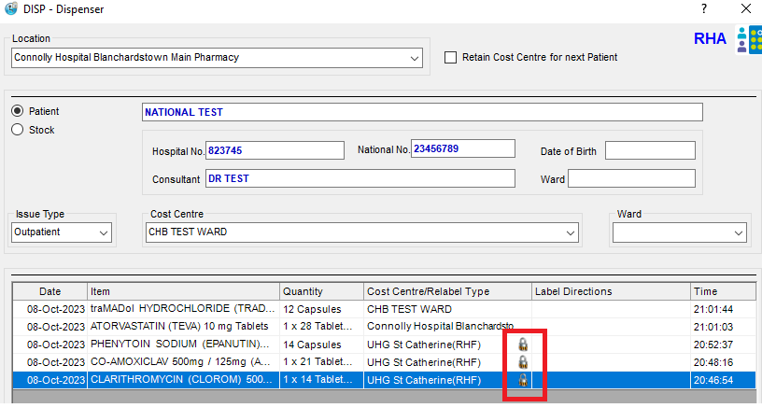
HMMS Single Patient Record
Medication Errors represent most common patient safety error
WHO “Half of the avoidable harm in health care is related to medications”
>40% of medication errors are during transitions of care
Single patient record improving patient safety by providing timely access to accurate information
Significant patient safety value with EPMA
Supports Activity Based Funding
Enhanced Reporting Capacity

Slide 15
HMMS and IHI
With the enactment of the Health Identifiers Act in 2014, residents and former residents in Ireland with a Personal Public Services Number (PPSN) were given an Individual Health Identifier (IHI) number.
It is used to uniquely identify each person engaging with the Health Service Executive and relevant social care agencies.
IHI utilized as the national number within HMMS to support a single patient record

Slide 16
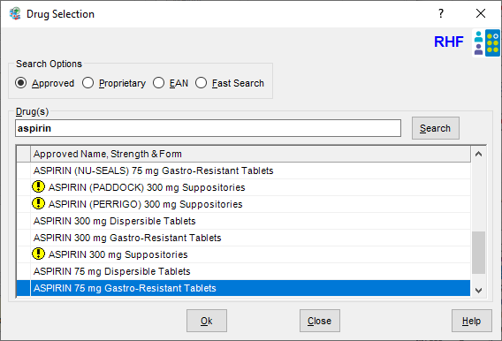
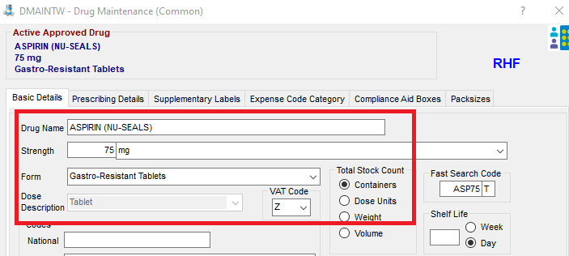
HMMS National Drug File
No comprehensive national drug file
Multiple drug databases used to develop initial file
>13,000 drug lines
Ongoing process
Includes both:
VMP (Virtual Medicinal Product) – utilised by EPMA
AMP (Actual Medicinal Product) – utilised by Pharmacy Stock Control System

Slide 17
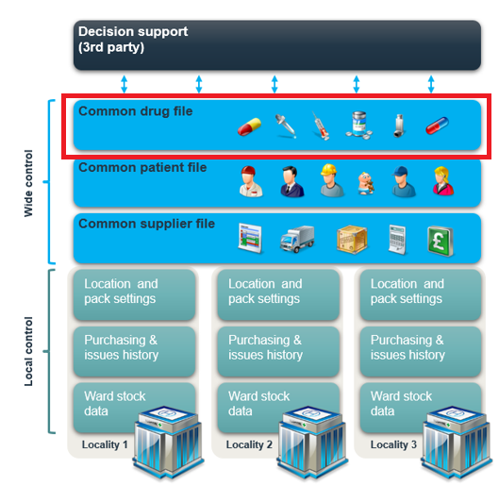
HMMS National Drug File
Development of DMAINTW = HMMS National (Common / national level) drug file
DMAINTW Data Structure
Drug name
Strength
Form
Dose description
VAT code
ATC code
Controlled drug
Unlicensed medicine
Fridge item
Supplementary labels
Expense code
Pack size
DMAINTW

Slide 18
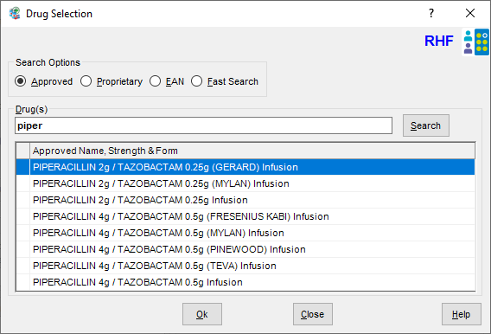
Standardisation of Drug Name
Example: Piperacillin / Tazobactam
PIPERACILLIN 4G + TAZOBACTAM 0.5G
PIPERACILLIN 4g TAZOBACTAM 0.5g!INJECTION (Fresenius)
PIPERACILLIN 4g TAZOBACTAM 0.5g!INJECTION (Mylan)
PIPERACILLIN 4G/TAZOBACTAM 500MG INJ
PIPERACILLIN SODIUM 4G/TAZOBACTAM SODIUM
PIPERACILLIN TAZO 4.5G INJECTION (MYLAN)
PIPERACILLIN TAZOBACTAM 4.5G (728830)
PIPERACILLIN/TAZOBACTAM
PIPERACILLIN/TAZOBACTAM 4.5 g Injection 1 x 4.5g Vial Pack
PIPERACILLIN/TAZOBACTAM 4.5 g Injection 10 x 4.5g Vial Pack
PIPERACILLIN/TAZOBACTAM 4.5 g Injection 100 x 4.5g Vial Pack
Piperacillin/Tazobactam 4.5g Inj
PIPERACILLIN/TAZOBACTAM 4.5G INJECTION
PIPERACILLIN/TAZOBACTAM 4.5G PWDR INJ
Piperacillin/Tazobactam 4.5g Pwdr Inj
PIPERACILLIN/TAZOBACTAM 4G/ 0.5G PDR INJ
Piperacillin/Tazobactam 4g/ 0.5g Pdr Inj
PIPERACILLIN/TAZOBACTAM 4G/0.5G INJ PW
Piperacillin/Tazobactam 4g/0.5g Inj PW
Piperacillin/Tazobactam 4g/0.5g Mylan
PIPERACILLIN/TAZOBACTAM 4G/0.5G MYLAN
PIPERACILLIN/TAZOBACTAM 4G/0.5G PDR INJ
Piperacillin/Tazobactam 4g/0.5g Pdr Inj
PIPERACILLIN/TAZOBACTAM 4G/0.5G PDR TEVA
Piperacillin/Tazobactam 4g/0.5g Sandoz
PIPERACILLIN/TAZOBACTAM 4G/0.5G SANDOZ
PIPERACILLIN/TAZOBACTAM 4G/0.5G VIAL
Piperacillin/Tazobactam 4g/0.5g Vial
PIPERACILLIN:TAZOBACTAM(MYLAN) VIAL 4G:0.5G 10 VIAL (10)
Piperacilline/Tazobactam Pwdr Sol Inf
PIPERCILLIN:TAZOBACTAM(SANDOZ) VIAL 4G:0.5G 10 VIAL (10)
Pipercin 4g/0.5g Vial
PIPERCIN 4G/0.5G VIAL
PIPERIN 4G/0.5G POWDER FOR INFUSION
Piperin 4g/0.5g Powder for Infusion
PIPERIN INJECTION 4g/0.5g
PIPERIN VIAL 4G:0.5G 10 VIAL (10)
TAZOCIN 4.5G INJECTION
Tazocin 4.5g Injection
Tazocin 4.5g Injection Infusion Pack
TAZOCIN 4G/0.5G INJECTION
TAZOCIN!4.5g!INJECTION

Slide 19
Utilisation of Tallman Lettering in HMMS
The HMMS National Drug file applies the FDA list of Tallman lettering to in the drug file
An additional pair cycloGEST / cytoTEC are included In the HMMS drug file. This is a pair that has been associated with medication safety event reports in Ireland.
Tall Man lettering is a method of applying uppercase lettering to sections of look-alike, sound-alike drug names to bring attention to the points of dissimilarity
e.g. traZODone tramadol
It has been shown to improve the accuracy of drug name perception and reduce errors due to drug name similarity

Slide 20
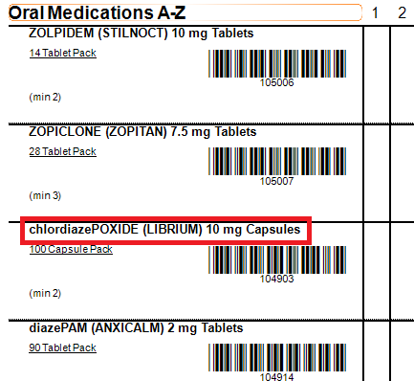
Application of Tallman Lettering in HMMS
Tallman lettering visible on the dispensing label
Tallman lettering visible on ward stock lists and picking lists
Tallman Lettering impacts alphabetical order of drugs in ward stock lists and picking lists
A-Z of drugs with uppercase first letter initially followed by A-Z of lowercase first letter drugs

Slide 21
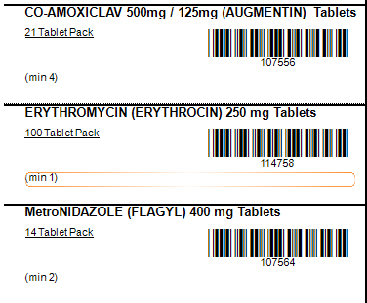
Adapted Tallman Workflow in HMMS
Engaged with Clinical Lead of the National Medication Safety Programme
Use uppercase for the first letter of all drug names in the HMMS National Drug File
Apply Tallman lettering format as per FDA, ISMP and IMSN recommendations to all other letters in a drug name where Tallman lettering should be utilised
e.g. metroNIDAZOLE change to MetroNIDAZOLE
Drugs will list A-Z in ward stock and picking lists

Slide 22
Standardisation - Drug Form
Be relevant to the information needed by a patient to understand the medicines product dispensed to them.
Be compatible with configuration limitations of the software e.g. 30 character limit for pharmaceutical dose forms
Convey the information needed to prevent selection errors by users, distinguishing between different medicinal products that share the same or similar tradenames.
Injection
concentrate &solvent for dispersion for injection | concentrate & solvent for solution for injection | concentrate & solvent for suspension for injection
emulsion for injection | emulsion for suspension for injection | gel for injection
powder & solvent for suspension for injection | powder for dispersion for injection | powder for solution for injection
concentrate for suspension for injection | dispersion for injection | emulsion for emulsion for injection
powder & solution for suspension for injection | powder & solvent for dispersion for injection | powder & solvent for solution for injection
powder for suspension for injection | solution for injection | solution for injection in cartridge
granules for suspension for injection | powder & solution for solution for injection
concentrate for dispersion for injection | concentrate for solution for injection

Slide 23
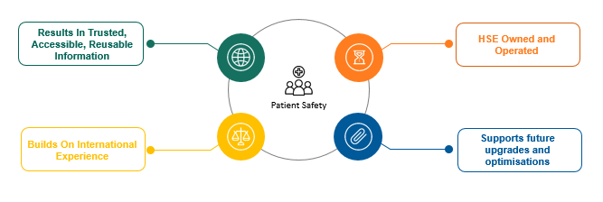
HMMS and NMPC
The National Medicinal Product Catalogue (NMPC) will deliver a national electronic dictionary of medicinal products
It will support patient safety by providing an accurate and consistent approach to the naming and identification of medicinal products in clinical activity.
This is particularly important where exchange or aggregation of information is needed between multiple care settings

Slide 24
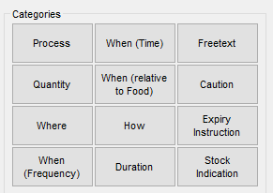
Dispensing Label Short Codes
HMMS supports the use of short codes to insert directions for use on a dispensing label
HMMS provide a number of short codes within software
System Reserved
Prepopulated codes
No short codes provided for:
When (time)
When (relative to food)
Caution (for two descriptions only)
HMMS employs a two character short code format for these categories

Slide 25
Dispensing Label Short Codes
When (relative to food) label direction short codes
When (relative frequency) label direction short codes
Description Code | HMMS code
before BREAKFAST | BR
after BREAKFAST | AB
at BREAKFAST time | BT
at BREAKFAST and LUNCH TIME | BL
at BREAKFAST, LUNCH and SUPPER TIME | LX
at BREAKFAST and SUPPER TIME | BS
at BREAKFAST, SUPPER and BED TIME | SX
at BREAKFAST and BED TIME | BB
at LUNCH TIME | LT
at LUNCH TIME and SUPPER TIME | LU
at SUPPER TIME | SU
before feeds | BF
after feeds | FD
before meals | BM
after meals | PC
HALF to ONE hour before food | 1F
before food | AC
with or after food | WF
with BREAKFAST | WB
with feeds | FE
with food or milk | WM
with LUNCH | WL
with meals | ME
an hour before food or on an empty stomach | ES
before exercise | EX
when required | PRN *
Description Code | HMMS code
every hour | Q1
every TWO hours | Q2
every THREE hours | Q3
every FOUR hours | Q4
every FIVE hours | Q5
every SIX hours | Q6
every four to six hours | 46
every EIGHT hours | Q8
every TWELVE hours | 12
ONCE a day | OD
TWICE a day | BD
THREE times a day | TD
THREE times a day and at BEDTIME | TT
FOUR times a day | QD
FIVE times a day | VD
SIX times a day | SD
Description Code | HMMS code
on ALTERNATE days | AD
every THREE days | 3D
every FOUR days | 4D
every FIVE days | 5D
every week | QW
ONCE a week | OW
TWICE a week | BW
THREE times a week | TW
every TWO weeks | 2W
every THREE weeks | 3W
every FOUR weeks | 4W
every month | QM
ONCE a month | OM
TWICE a month | 2M
THREE times a month | 3M
every TWO months | M2
every THREE months | M3
at NIGHT | N
at BEDTIME | HS
in the MORNING | MA
in the EVENING | TA
Description Code | HMMS code
NOT TO BE TAKEN ORALLY | NP
FOR INHALATION ONLY | IO
Caution label direction short codes

Slide 26
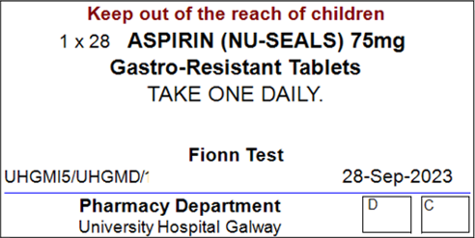
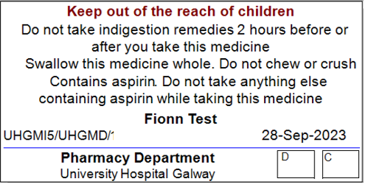
Supplementary Labels
Supplementary labels are assigned in the HMMS National Drug File in accordance with the British National Formulary.
Upon dispensing, the associated supplementary label will print on the label alongside the instructions.

Slide 27
Medicines Data
Pre HMMS Implementation
Post HMMS Implementation
Poor / no interoperability
Semantic interoperability
No standardisation
Standardisation
Robust data across sectors
Robust data flow - machine readable
Data silos across sectors
Robust data flow - machine readable
Robust data flow across sectors
No data reference sets
Structured data reference sets

Slide 28
HMMS Implementation Roadmap
Phase II Pharmacy
HMMS-HEPMA
HMMS-Pharmacy
Go-Live
27 nominated sites
Project Scoping
Project Governance
Stakeholder Engagement
Project Plan
Implementation
HMMS-Pharmacy
HMMS-EPMA Implementation
Phase I started May 2023
HMMS-Pharmacy
Go-Live - 6 Sites
Galway University
Phoenix Pharmacy
Rotunda
St Vincent's
Connolly Hospital
South Infirmary Cork

Slide 29
Questions
HMMS.contact@hse.ie

