Slide 1
Optimising communication for medication reviews in older adults with cancer
Darren J. Walsh ^{1,2,3}, Michelle O’Driscoll³, Laura J. Sahm ^{3,4}, Anne M. Horgan ²
Pharmacy Department, University Hospital Waterford
Oncology Department, University Hospital Waterford, Waterford, Ireland
Pharmaceutical Care Research Group, School of Pharmacy, University College Cork, Cork, Ireland
Department of Pharmacy, Mercy University Hospital, Grenville Place, Cork. Ireland

Slide 2
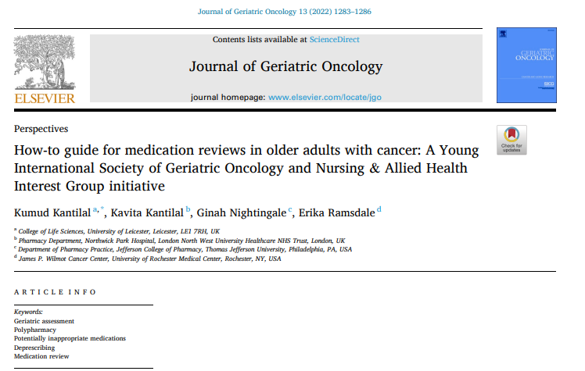
Background
International guidance on conducting medication reviews in older adults with cancer have been published since June 2022 (1)

Slide 3
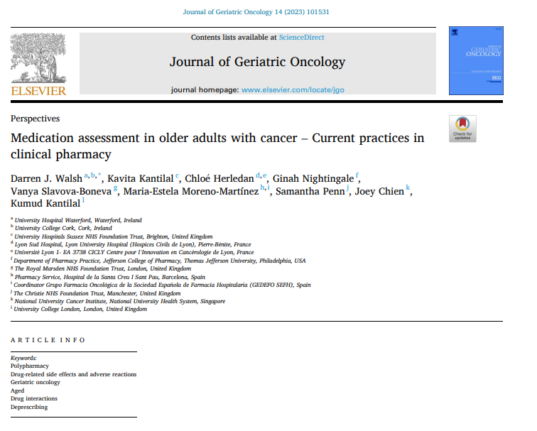
Background
Current clinical pharmacist practices have been outlined by pharmacists working in this field (2).

Slide 4
Aim
Issue: How do we communicate our recommendations effectively and efficiently to relevant stakeholders?
Aim: Identify a smart means of communicating recommendations from the medication review to stakeholders involved in caring for the patient.

Slide 5
Methods
Is T-pro (3), a medical dictation and clinical correspondence app, appropriate for pharmacist communication of medication review outcomes?
Develop data collection form (DW)
Verify the format and content (AH, LS, MO’D)
Geriatric oncology pharmacist dictates draft letter based on clinic consultation
Patient is discussed at geriatric oncology multidisciplinary team meeting (MDT)
Letter updated with MDT outcome
Letter printed and sent to relevant stakeholders

Slide 6
Outcomes
We identified a Tpro (3) dictated outpatient letter as the optimum technology to convey the results of a medication review by a clinical pharmacist in an outpatient setting
Tpro (3) letters are currently used to communicate from the outpatient clinic to relevant stakeholders by medical and nursing colleagues
We identified several benefits of using this technology to communicate between care stakeholders for older adults with cancer……

Slide 7
Stakeholder: General Practitioner
Medication related problems are clearly communicated to the GP, with recommended changes to optimise medication usage for chronic conditions.
Recommendations are referenced with rationale and primary source

Slide 8
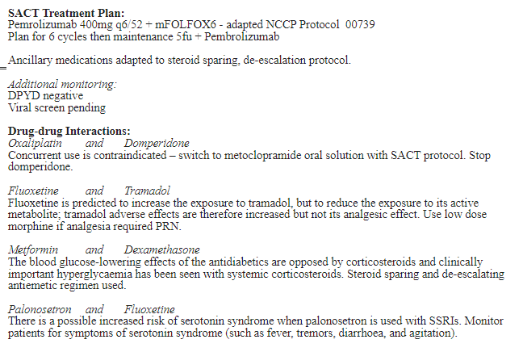
Stakeholder: General Practitioner
71yo male
Metastatic oesophageal cancer
Partial dysphagia in clinic- increasingly symptomatic

Slide 9
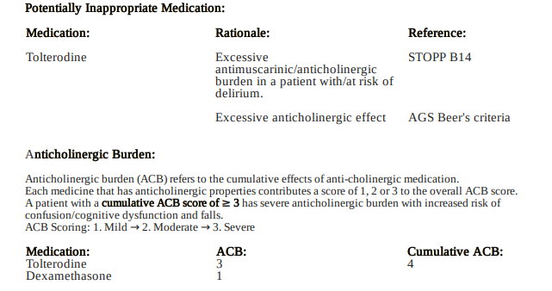
Stakeholder: Other relevant specialties
Where a potential medication related issue is affecting a medication managed by another specialty, they are cc’d on the letter

Slide 10
Stakeholder: Other relevant specialties
Where a potential medication related issue is affecting a medication managed by another specialty, they are cc’d on the letter

Slide 11
Stakeholder: Other relevant specialties
Where a potential medication related issue is affecting a medication managed by another specialty, they are cc’d on the letter

Slide 12
Stakeholder: Consultant Medical Oncologist
The patient’s medical oncologist is notified of potential optimal amendments to the standard of care for the patient, given their complex comorbidities, e.g., using a steroid sparing antiemetic regimen for a diabetic patient.
Issues – such as potential adherence issue with oral medication are explored and communicated to the consultant, which may result in optimisation of systemic therapy
71yo male
Metastatic oesophageal cancer
Partial dysphagia in clinic- increasingly symptomatic

Slide 13
Stakeholder: Consultant Medical Oncologist
71yo male
Metastatic oesophageal cancer
Partial dysphagia in clinic- increasingly symptomatic

Slide 14
Stakeholder: Community pharmacist
Changes and specialist counselling points, particularly regarding over-the-counter medication use can be communicated to the community pharmacist
At present in Ireland, community pharmacists do not typically receive correspondence from a tertiary hospital, apart from discharge prescriptions.

Slide 15
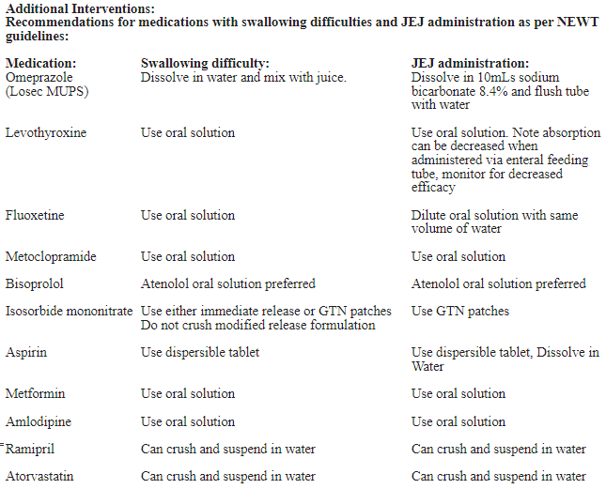
Stakeholder: Community pharmacist
71yo male
Metastatic oesophageal cancer
Partial dysphagia in clinic- increasingly symptomatic

Slide 16
Stakeholder: Patient medical notes
A copy of the letter is stored in the patient’s medical notes.
This provides the emergency department, and the clinical pharmacist in the hospital with a full medicines reconciliation, medication review and potential medication-related issues documented, prior to an unplanned hospitalisation, in the event of an admission.

Slide 17
Conclusion
TPro dictated outpatient letters are an advantageous method for communicating the outcomes of a medication review in an outpatient geriatric oncology clinic.
This tool is translatable across the public healthcare system in Ireland.
The benefits of this tool are not confined to geriatric oncology, and are easily adaptable to the clinical communication needs of any clinical pharmacist working in an outpatient clinic, or at discharge

Slide 18
References
Kantilal K, Kantilal K, Nightingale G, Ramsdale E. How-to guide for medication reviews in older adults with cancer: A Young International Society of Geriatric Oncology and Nursing & Allied Health Interest Group initiative. Journal of Geriatric Oncology.
Walsh DJ, Kantilal K, Herledan C, Nightingale G, Slavova-Boneva V, Moreno-Martínez M-E, et al. Medication assessment in older adults with cancer – Current practices in clinical pharmacy. Journal of Geriatric Oncology. 2023;14(5):101531.
T-Pro [Medical dictation, speech recognition and transcription software]. Available from: https://info.tpro.io/.

