Slide 1
Safety Culture in Irish Community Pharmacies: a cross-sectional study using the Community Pharmacy Survey on Patient Safety Culture
Edwin Wixted, Laura Gleeson, Oisín Kavanagh, Margaret Bermingham
School of Pharmacy, University College Cork

Slide 2
Background
Patient safety culture is
the product of individual and group values, attitudes, perceptions, competencies, and patterns of behaviour that determine the commitment to, and the style and proficiency of, an organisation’s health and safety management
Less research on patient safety culture in community pharmacy than in secondary care pharmacy settings

Slide 3
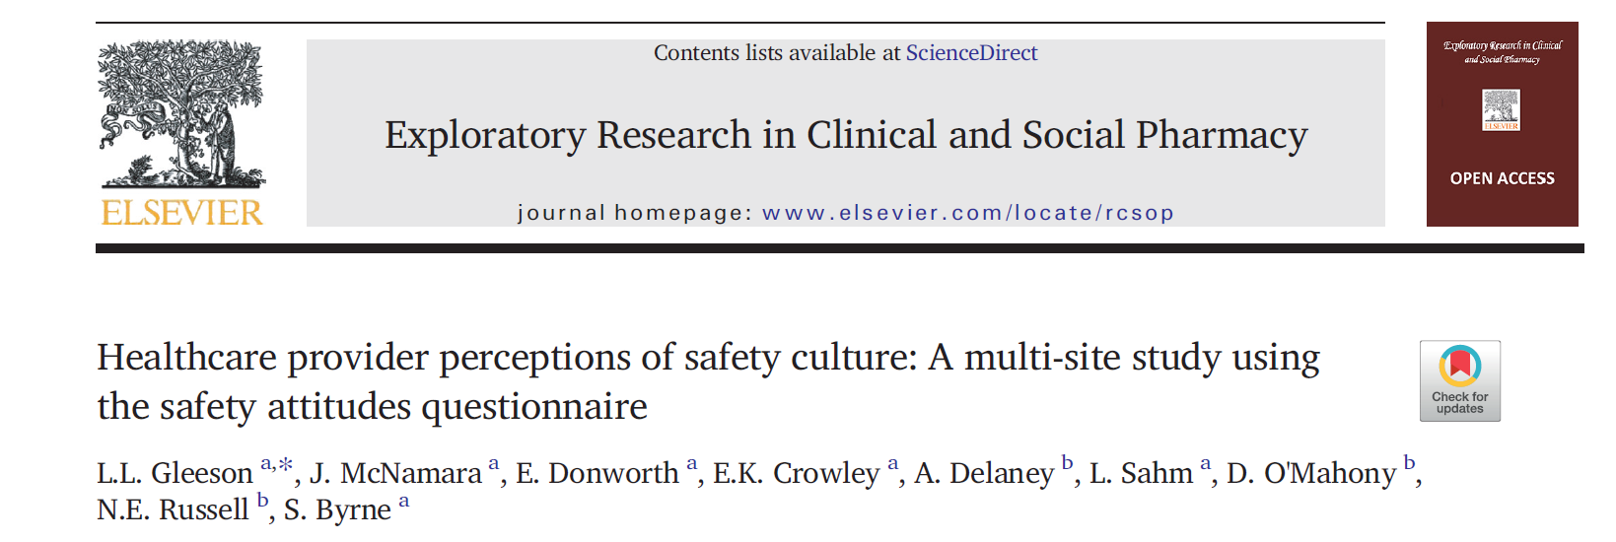
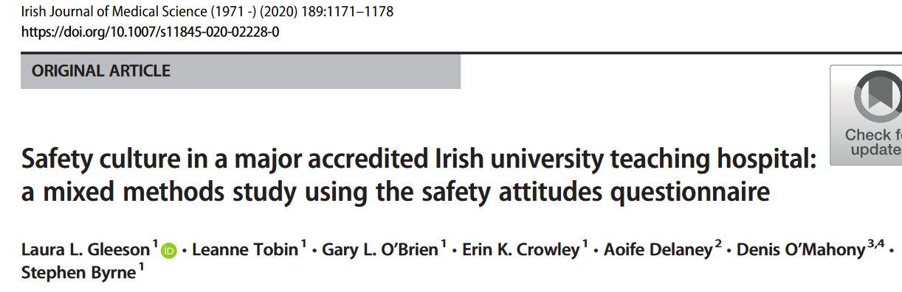
Irish Data on Safety Culture

Slide 4
Community Pharmacy Survey on Patient Safety Culture
Increasing use as research tool since 2016, primarily in Asia and Middle East
Highest positive responses are for the dimensions of teamwork and patient counselling
Lowest positive responses for staffing, work pressure, and pace
85% rate their community pharmacy setting as excellent, very good or good for overall patient safety culture.
No Irish or European data

Slide 5
Methods
40 Likert scale questions in 5 sections / 11 dimensions
Demographics
Free-text comments
Emailed to 3943 community pharmacists, Nov 2021.
The positive rate response (% PRR) of each question and dimension was calculated
% PRR is the mean percentage of positive Likert scale responses to each item and each dimension.

Slide 6
Results
Completed by 173 pharmacists, response rate 4.4%.

Slide 7
Results
High scoring individual statements | % PRR
Our pharmacists tell patients important information about their new prescriptions | 91.3
Staff are treated fairly when they make mistakes | 87.3
When a mistake happens, we try to figure out what problems in the work process led to the mistake | 86.7
Low scoring individual statements | % PRR
Interruptions/distractions in this pharmacy (from phone calls, faxes, customers, etc.) make it difficult for staff to work accurately | 6.4
We feel rushed when processing prescriptions | 8.1

Slide 8
Results

Slide 9
Results
Attitude to safety culture
“Most pharmacists don’t pay enough attention to how to prevent dispensing errors until something happens.”
Distractions
“Distractions like pharmacists trying to do vaccines and then coming back in checking prescriptions causes a stressful environment and maybe leads to mistakes being made.”
Work environment and staffing
“We’re very aware of best practice but time constraints mean it simply isn’t always possible.”

Slide 10
Conclusion
Pharmacists working in community pharmacy sector in Ireland reported a generally positive safety culture.
Low safety culture scores were reported for the dimension of Staffing, Work Pressure, and Pace - supported by thematic analysis of free-text comments.
Aligns with international findings.
Differences in perception of safety culture observed between pharmacists with differing levels of managerial responsibility.

Slide 11
References
What is patient safety culture? Agency for Healthcare Research and Quality. Published online March 2022. https://www.ahrq.gov/sops/about/patient-safety-culture.html
Gleeson LL, McNamara J, Donworth E, et al. Healthcare provider perceptions of safety culture: A multi-site study using the safety attitudes questionnaire. Explor Res Clin Soc Pharm. 2023;9:100228.
Gleeson LL, O’Brien GL, O’Mahony D, Byrne S. Thirst for change in a challenging environment: healthcare providers’ perceptions of safety culture in a large Irish teaching hospital. Ir J Med Sci. 2022;191(2):607-613.
Gleeson LL, Tobin L, O’Brien GL, et al. Safety culture in a major accredited Irish university teaching hospital: a mixed methods study using the safety attitudes questionnaire. Ir J Med Sci. 2020;189(4):1171-1178.
2012 Preliminary Comparative Results: Pharmacy Survey on Patient Safety Culture. Agency for Healthcare Research and Quality; 2012.
Kwon KE, Nam DR, Lee MS, Kim SJ, Lee JE, Jung SY. Status of Patient Safety Culture in Community Pharmacy Settings: A Systematic Review. J Patient Saf. 2023;19(6):353-361.

Slide 12
Contact
Dr Margaret Bermingham
margaret.bermingham@ucc.ie
@margbermingham

